Slide 1
Descriptive Statistics
Chapter 2

Slide 2
Overview of Using Data: Definitions and Goals

Slide 3
Overview of Using Data: Definitions and Goals (Slide 1 of 5)
Data: The facts and figures collected, analyzed, and summarized for presentation and interpretation.
Variable: A characteristic or a quantity of interest that can take on different values.
Observation: A set of values corresponding to a set of variables.
Variation: The difference in a variable measured over observations.
Random variable/uncertain variable: A quantity whose values are not known with certainty.
Notes:
When we collect data, we are gathering past observed values, or realizations of a variable.
By collecting these past realizations of one or more variables, our goal is to learn more about the variation of a particular business situation.

Slide 4
Overview of Using Data: Definitions and Goals (Slide 2 of 5)
Table 2.1: Data for Dow Jones Industrial Index Companies
Company | Symbol | Industry | Share Price ($) | Volume
Apple | AAPL | Technology | 160.47 | 18,997,275
American Express | AXP | Financial | 91.69 | 2,939,556
Boeing | BA | Manufacturing | 258.62 | 2,515,865
Caterpillar | CAT | Manufacturing | 130.54 | 2,380,342
Cisco Systems | CSCO | Technology | 33.60 | 9,303,117
Chevron Corporation | CVX | Chemical, Oil, and Gas | 120.22 | 4,844,293
DuPont | DD | Chemical, Oil, and Gas | 83.93 | 34,861,021
Notes:
For the data in Table 2.1:
Variables: Symbol, Industry, Share Price, and Volume
Observation: Each row in Table 2.1
Variation: Time, customers, items, etc.

Slide 5
Overview of Using Data: Definitions and Goals (Slide 3 of 5)
Table 2.1: Data for Dow Jones Industrial Index Companies (cont.)
Company | Symbol | Industry | Share Price ($) | Volume
Disney | DIS | Entertainment | 98.36 | 5,942,501
General Electric | GE | Conglomerate | 23.19 | 58,639,089
Goldman Sachs | GS | Financial | 236.09 | 7,088,445
The Home Depot | HD | Retail | 163.35 | 4,189,197
IBM | IBM | Technology | 146.54 | 6,372,393
Intel | INTC | Technology | 39.79 | 15,532,818
Johnson & Johnson | JNJ | Pharmaceuticals | 140.79 | 11,717,348
JPMorgan Chase | JPM | Banking | 97.62 | 10,335,687
Notes:
For the data in Table 2.1:
Variables: Symbol, Industry, Share Price, and Volume
Observation: Each row in Table 2.1
Variation: Time, customers, items, etc.

Slide 6
Overview of Using Data: Definitions and Goals (Slide 4 of 5)
Table 2.1: Data for Dow Jones Industrial Index Companies (cont.)
Company | Symbol | Industry | Share Price ($) | Volume
Coca-Cola | KO | Food and Drink | 46.52 | 7,699,367
McDonald’s | MCD | Food and Drink | 165.40 | 2,379,725
3M | MMM | Conglomerate | 217.75 | 2,150,810
Merck | MRK | Pharmaceuticals | 63.22 | 7,028,492
Microsoft | MSFT | Technology | 77.59 | 16,823,989
Nike | NKE | Consumer Goods | 52.00 | 9,492,675
Pfizer | PFE | Pharmaceuticals | 36.20 | 14,019,661
Procter & Gamble | PG | Consumer Goods | 92.80 | 5,316,062
Notes:
For the data in Table 2.1:
Variables: Symbol, Industry, Share Price, and Volume
Observation: Each row in Table 2.1
Variation: Time, customers, items, etc.

Slide 7
Overview of Using Data: Definitions and Goals (Slide 5 of 5)
Table 2.1: Data for Dow Jones Industrial Index Companies (cont.)
Company | Symbol | Industry | Share Price ($) | Volume
Travelers | TRV | Insurance | 128.62 | 1,808,224
UnitedHealth Group | UNH | Healthcare | 203.89 | 8,949,715
United Technologies | UTX | Conglomerate | 119.36 | 2,026,513
Visa | V | Financial | 107.54 | 5,979,405
Verizon | VZ | Telecommunications | 48.40 | 14,842,814
Wal-Mart | WMT | Retail | 85.98 | 5,851,546
ExxonMobil | XOM | Chemical, Oil, and Gas | 82.96 | 6,444,106
Notes:
For the data in Table 2.1:
Variables: Symbol, Industry, Share Price, and Volume
Observation: Each row in Table 2.1
Variation: Time, customers, items, etc.

Slide 8
Types of Data
Population and Sample Data
Quantitative and Categorical Data
Cross-Sectional and Time Series Data
Sources of Data

Slide 9
Types of Data (Slide 1 of 5)
Population and Sample Data
Population: All elements of interest.
Sample: Subset of the population.
Random sampling: A sampling method to gather a representative sample of the population data.
Quantitative and Categorical Data
Quantitative data: Data on which numeric and arithmetic operations, such as addition, subtraction, multiplication, and division, can be performed.
Categorical data: Data on which arithmetic operations cannot be performed.
Notes:
Examples:
Population: With the thousands of publicly traded companies in the United States, tracking and analyzing all of these stocks every day would be too time consuming and expensive.
Sample: The Dow represents a sample of 30 stocks of large public companies based in the United States, and it is often interpreted to represent the larger population of all publicly traded companies.
Quantitative data: The values for Volume in the Dow data in Table 2.1 can be summed to calculate a total volume of all shares traded by companies included in the Dow.
Categorical data: The data in the Industry column in Table 2.1 are categorical. For example, the number of companies in the Dow that are in the telecommunications industry can be counted.

Slide 10
Types of Data (Slide 2 of 5)
Cross-Sectional and Time Series Data
Cross-sectional data: Data collected from several entities at the same, or approximately the same, point in time.
Time series data: Data collected over several time periods.
Graphs of time series data are frequently found in business and economic publications.
Graphs help analysts understand what happened in the past, identify trends over time, and project future levels for the time series.
Notes:
Example:
Cross-sectional data: The data in Table 2.1 are cross-sectional because they describe the 30 companies that comprise the Dow at the same point in time (October 2017).

Slide 11
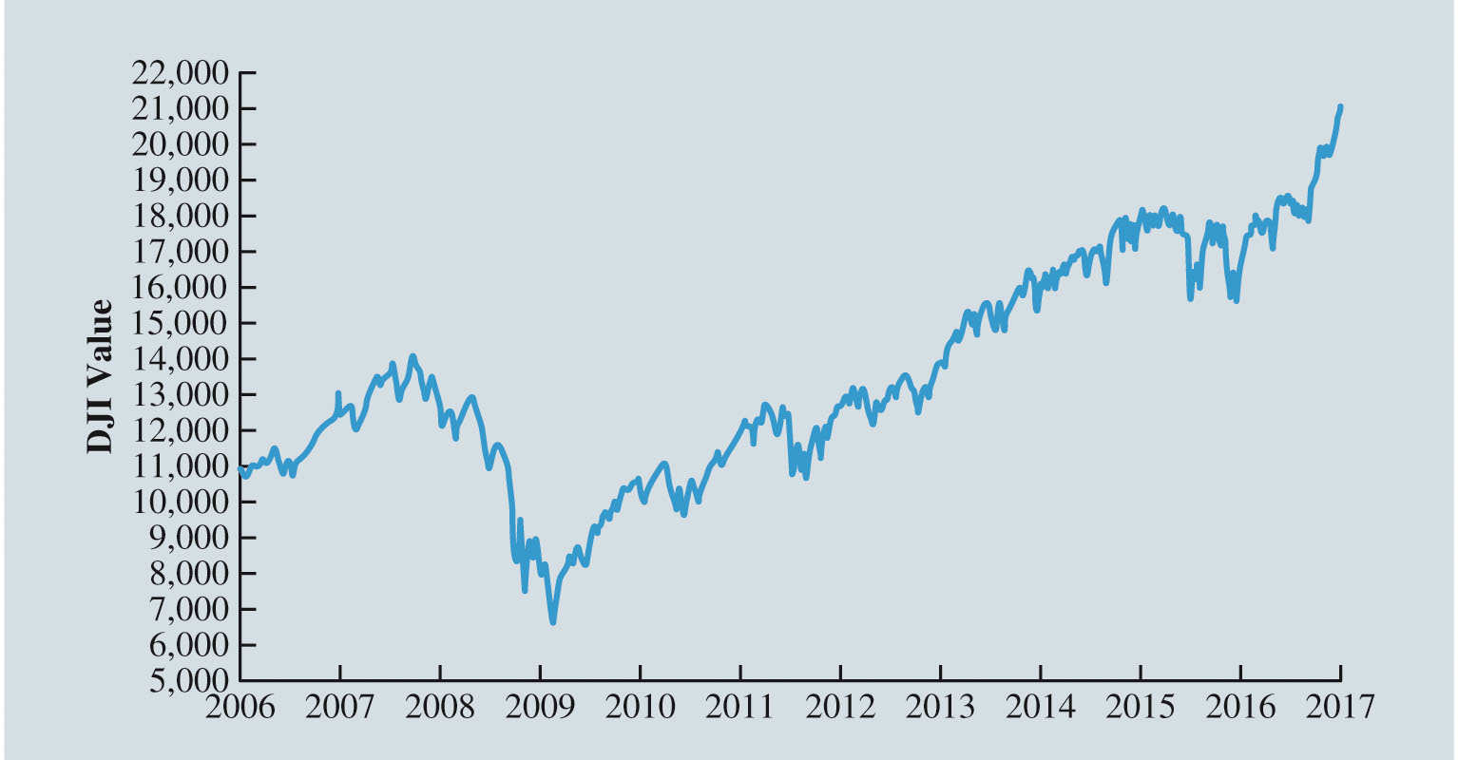
Types of Data (Slide 3 of 5)
Figure 2.1: Dow Jones Index Values Since 2006
Notes:
Example: (cont.)
Time series data: Figure 2.1 illustrates that the DJI climbed to above 14,000 in 2007. However, the financial crisis in 2008 led to a significant decline in the DJI to between 6,000 and 7,000 by 2009. Since 2009, the DJI has been generally increasing and topped 21,000 in 2017.

Slide 12
Types of Data (Slide 4 of 5)
Sources of Data
Experimental study
A variable of interest is first identified.
Then one or more other variables are identified and controlled or manipulated so that data can be obtained about how they influence the variable of interest.
Nonexperimental study or observational study
Makes no attempt to control the variables of interest.
A survey is perhaps the most common type of observational study.
Notes:
Example of experimental study:
If a pharmaceutical firm is interested in conducting an experiment to learn about how a new drug affects blood pressure, then blood pressure is the variable of interest in the study.
The dosage level of the new drug is another variable that is hoped to have a causal effect on blood pressure.
To obtain data about the effect of the new drug, researchers select a sample of individuals.
The dosage level of the new drug is controlled as different groups of individuals are given different dosage levels.
Before and after the study, data on blood pressure are collected for each group.
Statistical analysis of these experimental data can help determine how the new drug affects blood pressure.

Slide 13

Types of Data (Slide 5 of 5)
Figure 2.2: Customer Opinion Questionnaire Used by Chops City Grill Restaurant
Notes:
Example of nonexperimental study:
Figure 2.2 shows a customer opinion questionnaire used by Chops City Grill in Naples, Florida.
Note that the customers who fill out the questionnaire are asked to provide ratings for 12 variables, including overall experience, the greeting by hostess, the table visit by the manager, overall service, and so on.
The response categories of excellent, good, average, fair, and poor provide categorical data that enable Chops City Grill management to maintain high standards for the restaurant’s food and service.
In some cases, the data needed for a particular application exist from an experimental or observational study already conducted.
Companies maintain a variety of databases about their employees, customers, and business operations.

Slide 14
Modifying Data in Excel
Sorting and Filtering Data in Excel
Conditional Formatting of Data in Excel

Slide 15
Modifying Data in Excel (Slide 1 of 14)
Table 2.2: 20 Top-Selling Automobiles in United States in March 2011
Rank (by March 2011 Sales) | Manufacturer | Model | Sales (March 2011) | Sales (March 2010)
1 | Honda | Accord | 33,616 | 29,120
2 | Nissan | Altima | 32,289 | 24,649
3 | Toyota | Camry | 31,464 | 36,251
4 | Honda | Civic | 31,213 | 22,463
5 | Toyota | Corolla/Matrix | 30,234 | 29,623
6 | Ford | Fusion | 27,566 | 22,773
7 | Hyundai | Sonata | 22,894 | 18,935
8 | Hyundai | Elantra | 19,255 | 8,225

Slide 16
Modifying Data in Excel (Slide 2 of 14)
Table 2.2: 20 Top-Selling Automobiles in United States in March 2011 (cont.)
Rank (by March 2011 Sales) | Manufacturer | Model | Sales (March 2011) | Sales (March 2010)
9 | Toyota | Prius | 18,605 | 11,786
10 | Chevrolet | Cruze/Cobalt | 18,101 | 10,316
11 | Chevrolet | Impala | 18,063 | 15,594
12 | Nissan | Sentra | 17,851 | 8,721
13 | Ford | Focus | 17,178 | 19,500
14 | Volkswagen | Jetta | 16,969 | 9,196
15 | Chevrolet | Malibu | 15,551 | 17,750
16 | Mazda | 3 | 12,467 | 11,353

Slide 17
Modifying Data in Excel (Slide 3 of 14)
Table 2.2: 20 Top-Selling Automobiles in United States in March 2011 (cont.)
Rank (by March 2011 Sales) | Manufacturer | Model | Sales (March 2011) | Sales (March 2010)
17 | Nissan | Versa | 11,075 | 13,811
18 | Subaru | Outback | 10,498 | 7,619
19 | Kia | Soul | 10,028 | 5,106
20 | Ford | Fiesta | 9,787 | 0

Slide 18
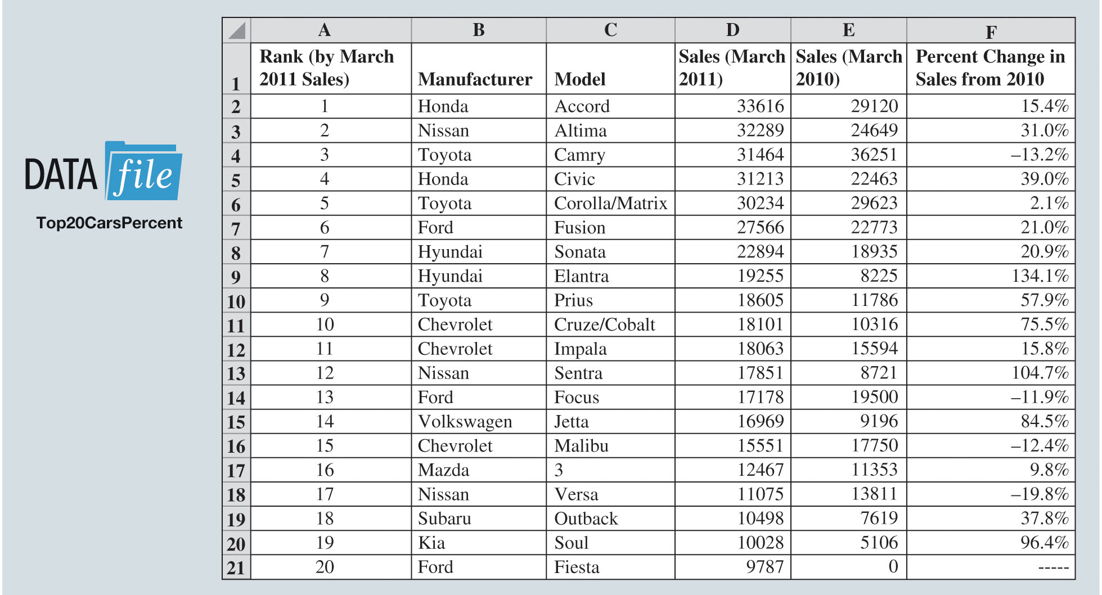
Modifying Data in Excel (Slide 4 of 14)
Figure 2.3: Data for 20 Top-Selling Automobiles Entered into Excel with Percentage Change in Sales from 2010
Notes:
Figure 2.3 shows the data from Table 2.2 entered into an Excel spreadsheet, and the percent change in sales for each model from March 2010 to March 2011 has been calculated.
This is done by entering the formula = (D2-E2)/E2 in cell F2 and then copying the contents of this cell to cells F3 to F20.

Slide 19
Modifying Data in Excel (Slide 5 of 14)
Sorting and Filtering Data in Excel
To sort the automobiles by March 2010 sales:
Step 1: Select cells A1:F21.
Step 2: Click the Data tab in the Ribbon.
Step 3: Click Sort in the Sort & Filter group.
Step 4: Select the check box for My data has headers.
Step 5: In the first Sort by dropdown menu, select Sales (March 2010).
Step 6: In the Order dropdown menu, select Largest to Smallest.
Step 7: Click OK.

Slide 20
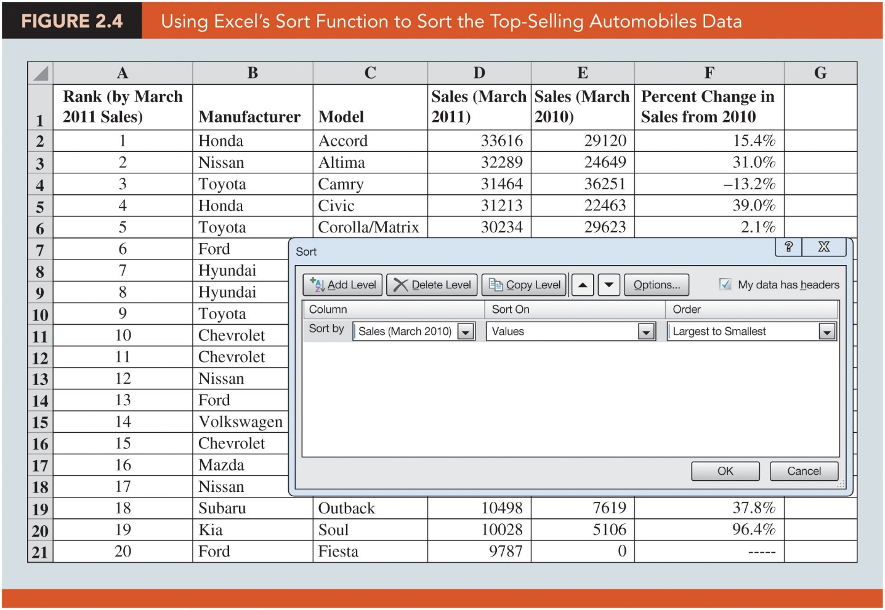
Modifying Data in Excel (Slide 6 of 14)
Figure 2.4: Using Excel’s Sort Function to Sort the Top-Selling Automobiles Data

Slide 21
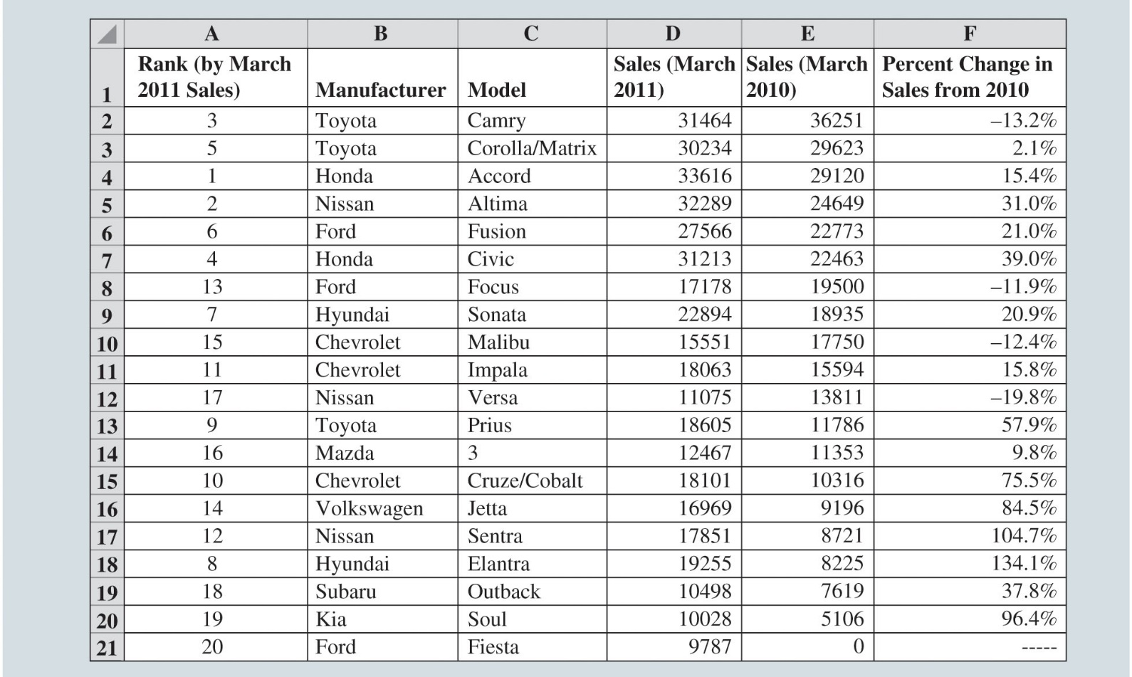
Modifying Data in Excel (Slide 7 of 14)
Figure 2.5: Top-Selling Automobiles Data Sorted by Sales in March 2010 Sales
Notes:
The result of using Excel’s Sort function for the March 2010 data is shown in Figure 2.5.
Although the Honda Accord was the best-selling automobile in March 2011, both the Toyota Camry and the Toyota Corolla/Matrix outsold the Honda Accord in March 2010.
Note that while Sales (March 2010), which is in column E, is sorted, the data in all other columns are adjusted accordingly.

Slide 22
Modifying Data in Excel (Slide 8 of 14)
Sorting and Filtering Data in Excel (cont.)
Using Excel’s Filter function to see the sales of models made by Toyota:
Step 1: Select cells A1:F21.
Step 2: Click the Data tab in the Ribbon.
Step 3: Click Filter in the Sort & Filter group.
Step 4: Click on the Filter Arrow in column B, next to Manufacturer.
Step 5: If all choices are checked, you can easily deselect all choices by unchecking (Select All). Then select only the check box for Toyota.
Step 6. Click OK.

Slide 23
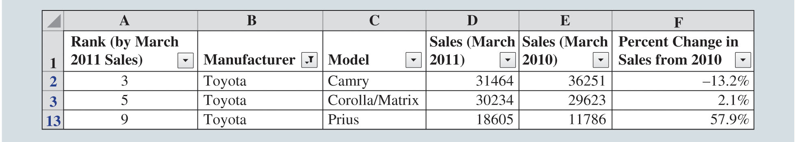
Modifying Data in Excel (Slide 9 of 14)
Figure 2.6: Top Selling Automobiles Data Filtered to Show Only Automobiles Manufactured by Toyota
Notes:
The result (Figure 2.6) is a display of only the data for models made by Toyota.
Of the 20 top-selling models in March 2011, Toyota made three of them.
Further filter the data by choosing the down arrows in the other columns.
All data can be made visible again by clicking on the down arrow in column B and checking (Select All) or by clicking Filter in the Sort & Filter Group again from the Data tab.

Slide 24
Modifying Data in Excel (Slide 10 of 14)
Conditional Formatting of Data in Excel:
Makes it easy to identify data that satisfy certain conditions in a data set.
To identify the automobile models in Table 2.2 for which sales had decreased from March 2010 to March 2011:
Step 1: Starting with the original data shown in Figure 2.3, select cells F1:F21.
Step 2: Click on the Home tab in the Ribbon.
Step 3: Click Conditional Formatting in the Styles group.
Step 4: Select Highlight Cells Rules, and click Less Than from the dropdown menu.
Step 5: Enter 0% in the Format cells that are LESS THAN: box.
Step 6: Click OK.

Slide 25
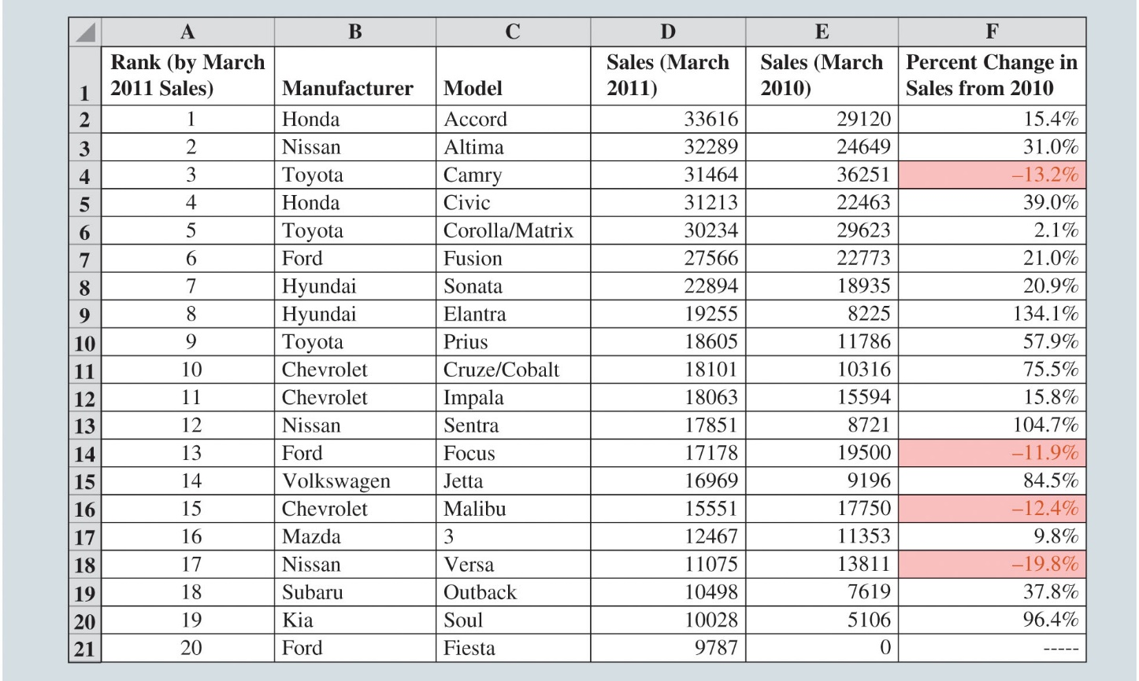
Modifying Data in Excel (Slide 11 of 14)
Figure 2.7: Using Conditional Formatting in Excel to Highlight Automobiles with Declining Sales from March 2010
Notes:
Here, the models with decreasing sales (Toyota Camry, Ford Focus, Chevrolet Malibu, and Nissan Versa) are now clearly visible.

Slide 26
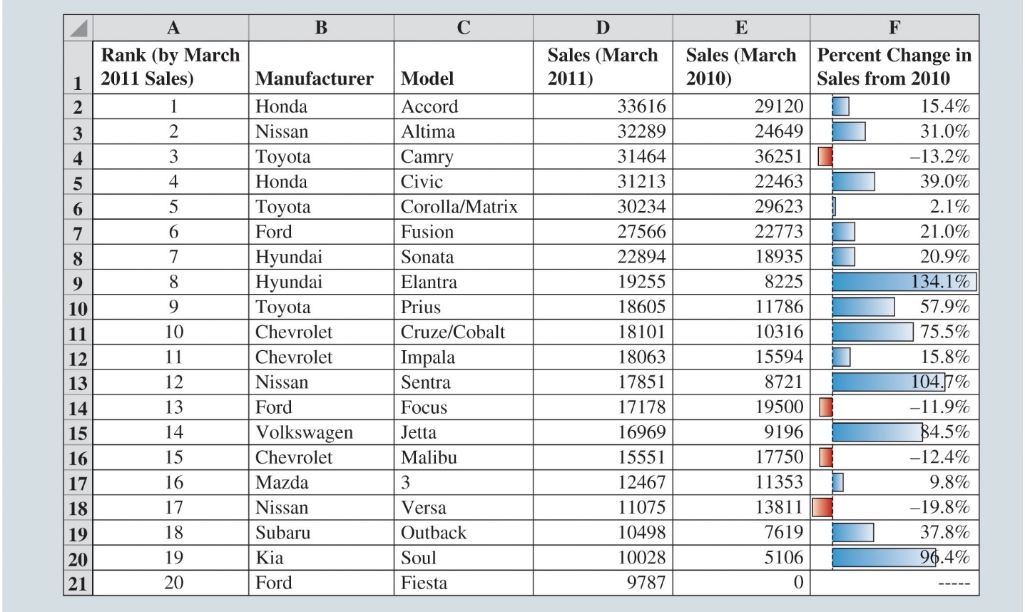
Modifying Data in Excel (Slide 12 of 14)
Figure 2.8: Using Conditional Formatting in Excel to Generate Data Bars for the Top-Selling Automobiles Data
Notes:
We can choose Data Bars from the Conditional Formatting dropdown menu in the Styles Group of the Home tab in the Ribbon.
Data bars are essentially a bar chart input into the cells that show the magnitude of the cell values.
The width of the bars in this display are comparable to the values of the variable for which the bars have been drawn; a value of 20 creates a bar twice as wide as that for a value of 10.
Negative values are shown to the left side of the axis; positive values are shown to the right.
Cells with negative values are shaded in a color different from that of cells with positive values.

Slide 27
Modifying Data in Excel (Slide 13 of 14)
Conditional Formatting of Data in Excel (cont.)
Quick Analysis button appears just outside the bottom-right corner of a group of selected cells.
It provides shortcuts for Conditional Formatting, adding Data Bars, and other operations.

Slide 28
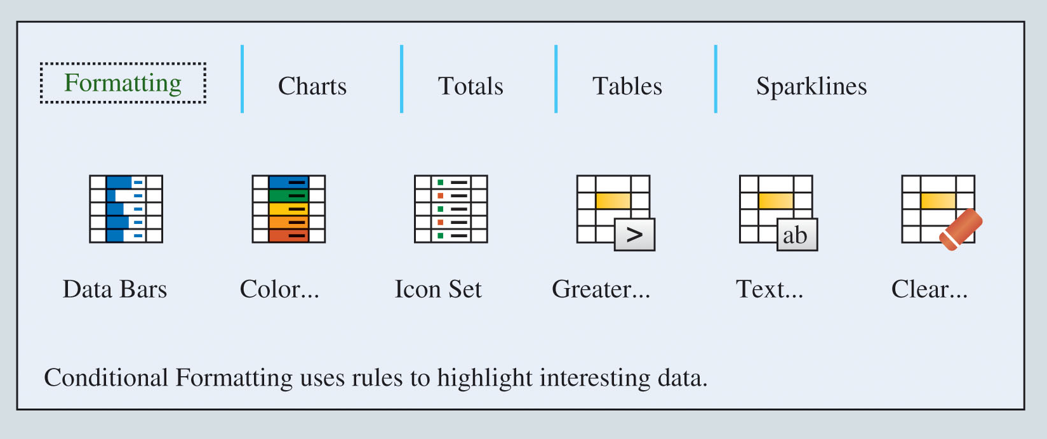
Modifying Data in Excel (Slide 14 of 14)
Figure 2.9 Excel Quick Analysis Button Formatting Options

Slide 29
Creating Distributions from Data
Frequency Distributions for Categorical Data
Relative Frequency and Percent Frequency Distributions
Frequency Distributions for Quantitative Data
Histograms
Cumulative Distributions

Slide 30
Creating Distributions from Data (Slide 1 of 18)
Frequency Distributions for Categorical Data:
Frequency distribution: A summary of data that shows the number (frequency) of observations in each of several nonoverlapping classes.
Typically referred to as bins, when dealing with distributions.

Slide 31
Creating Distributions from Data (Slide 2 of 18)
Table 2.3: Data from a Sample of 50 Soft Drink Purchases
Coca-Cola
Diet Coke
Pepsi
Diet Coke
Coca-Cola
Coca-Cola
Dr. Pepper
Diet Coke
Pepsi
Pepsi
Coca-Cola
Dr. Pepper
Sprite
Coca-Cola
Diet Coke
Coca-Cola
Coca-Cola
Sprite
Coca-Cola
Diet Coke
Coca-Cola
Diet Coke
Coca-Cola
Sprite
Pepsi
Coca-Cola
Coca-Cola
Coca-Cola
Pepsi
Coca-Cola
Sprite
Dr. Pepper
Pepsi
Diet Coke
Pepsi
Coca-Cola
Coca-Cola
Coca-Cola
Pepsi
Dr. Pepper
Coca-Cola
Diet Coke
Pepsi
Pepsi
Pepsi
Pepsi
Coca-Cola
Dr. Pepper
Pepsi
Sprite
Notes:
The data in Table 2.3 is taken from a sample of 50 soft drink purchases.
Each purchase is for one of five popular soft drinks, which define the five bins: Coca-Cola, Diet Coke, Dr. Pepper, Pepsi, and Sprite.

Slide 32
Creating Distributions from Data (Slide 3 of 18)
Table 2.4: Frequency Distribution of Soft Drink Purchases
Soft Drink | Frequency
Coca-Cola | 19
Diet Coke | 8
Dr. Pepper | 5
Pepsi | 13
Sprite | 5
Total | 50
The frequency distribution summarizes information about the popularity of the five soft drinks:
Coca-Cola is the leader.
Pepsi is second.
Diet Coke is third.
Sprite and Dr. Pepper are tied for fourth.
Notes:
The frequency distribution of soft drink purchases (Table 2.4) is obtained by counting the number of times each soft drink appears in Table 2.3.
Coca-Cola appears 19 times, Diet Coke appears 8 times, Dr. Pepper appears 5 times, Pepsi appears 13 times, and Sprite appears 5 times.
This frequency distribution provides a summary of how the 50 soft drink purchases are distributed across the 5 soft drinks.

Slide 33
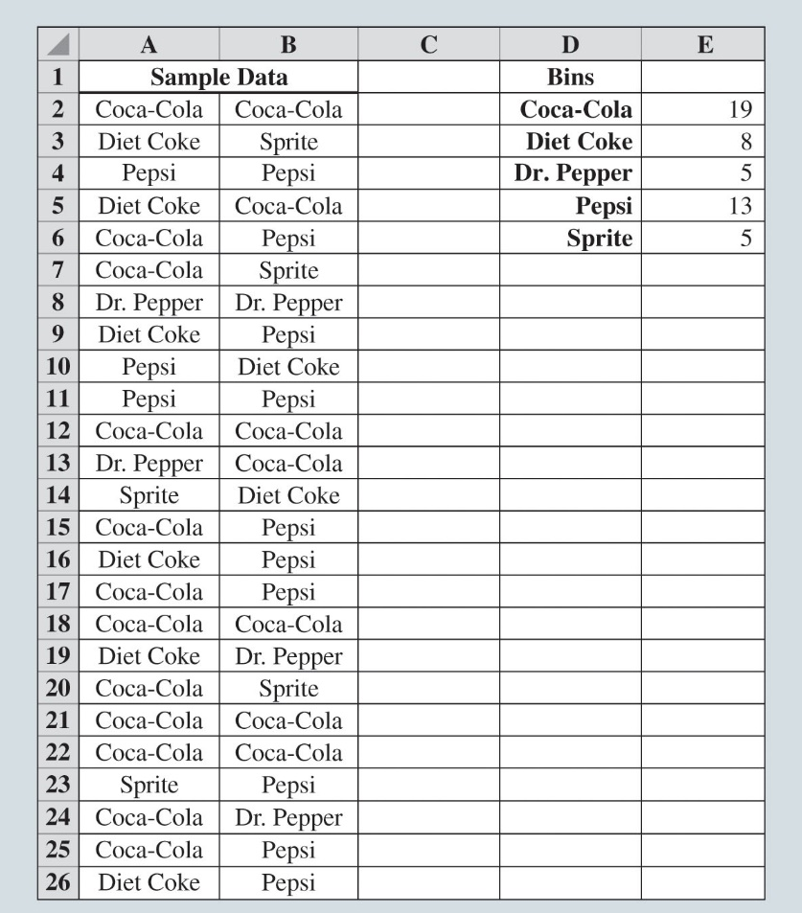
Creating Distributions from Data (Slide 4 of 18)
Figure 2.10: Creating a Frequency Distribution for Soft Drinks Data in Excel
Notes:
Figure 2.10 shows the sample of 50 soft drink purchases in an Excel spreadsheet.
Column D contains the five different soft drink categories as the bins.
In cell E2, enter the formula =COUNTIF($A$2:$B$26, D2), where A2:B26 is the range for the sample data, and D2 is the bin (Coca-Cola) to match.
The COUNTIF function in Excel counts the number of times a certain value appears in the indicated range.
In this case, we want to count the number of times Coca-Cola appears in the sample data. The result is a value of 19 in cell E2, indicating that Coca-Cola appears 19 times in the sample data.
The formula from cell E2 to cells E3 to E6 can be copied to get frequency counts for Diet Coke, Pepsi, Dr. Pepper, and Sprite. By using the absolute reference $A$2:$B$26 in the formula.

Slide 34
Creating Distributions from Data (Slide 5 of 18)
Relative Frequency and Percent Frequency Distributions
Relative frequency distribution: A tabular summary of data showing the relative frequency for each bin.
Percent frequency distribution: Summarizes the percent frequency of the data for each bin.
Percent frequency distribution is used to provide estimates of the relative likelihoods of different values of a random variable.

Slide 35
Creating Distributions from Data (Slide 6 of 18)
Table 2.5: Relative Frequency and Percent Frequency Distributions of Soft Drink Purchases
Soft Drink | Relative Frequency | Percent Frequency (%)
Coca-Cola | 0.38 | 38
Diet Coke | 0.16 | 16
Dr. Pepper | 0.10 | 10
Pepsi | 0.26 | 26
Sprite | 0.10 | 10
Total | 1.00 | 100
Notes:
Table 2.5 shows that the relative frequency for Coca-Cola is 19/50 = 0.38, the relative frequency for Diet Coke is 8/50 = 0.16, and so on.
From the percent frequency distribution, it is seen that 38% of the purchases were Coca-Cola, 16% of the purchases were Diet Coke, and so on.
Note that 38% + 26% + 16% = 80% of the purchases were the top three soft drinks.

Slide 36
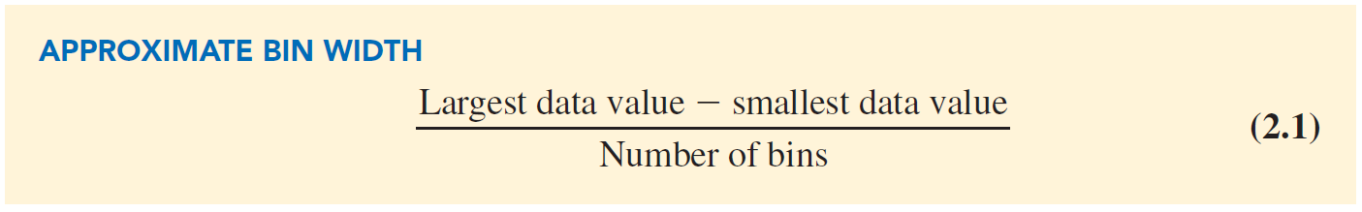
Creating Distributions from Data (Slide 7 of 18)
Frequency Distributions for Quantitative Data
Three steps are necessary to define the classes for a frequency distribution with quantitative data:
Determine the number of nonoverlapping bins.
Determine the width of each bin.
Determine the bin limits.
Notes:
Number of bins:
Bins are formed by specifying the ranges used to group the data.
Generally, use between 5 and 20 bins.
Small number of data items - five or six bins.
Larger number of data items - more bins are required.
The goal is to use enough bins to show the variation in the data, but not so many that some contain only a few data items.
Width of the bins:
It should be the same for each bin.
Thus the choices of the number of bins and the width of bins are not independent decisions.
A larger number of bins means a smaller bin width and vice versa.
Approximate bin width = $\frac{\text{Largest} \text{data} \text{value} − \text{smallest} \text{data} \text{value}}{\text{Number} \text{of} \text{bins}}$
Bin limits:
Bin limits must be chosen so that each data item belongs to one and only one class.
The lower bin limit identifies the smallest possible data value assigned to the bin.
The upper bin limit identifies the largest possible data value assigned to the class.

Slide 37
Creating Distributions from Data (Slide 8 of 18)
Table 2.6: Year-End Audit Times (Days)
12 | 14 | 19 | 18
15 | 15 | 18 | 17
20 | 27 | 22 | 23
22 | 21 | 33 | 28
14 | 18 | 16 | 13
Notes:
Number of bins:
The number of data items in Table 2.6 is relatively small (n = 20). Hence, we choose to develop a frequency distribution with five bins.
Width of bins:
The largest data value is 33, and the smallest data value is 12.
Because we decided to summarize the data with five classes, using the expression “Approximate bin width = $\frac{\text{Largest} \text{data} \text{value} − \text{smallest} \text{data} \text{value}}{\text{Number} \text{of} \text{bins}}$”, provides an approximate bin width of (33 – 12)/5 = 4.2.
We therefore decided to round up and use a bin width of five days in the frequency distribution.
Bin limits:
We selected 10 days as the lower bin limit and 14 days as the upper bin limit for the first class. This bin is denoted 10–14 in Table 2.7.
The smallest data value, 12, is included in the 10–14 bin. We then selected 15 days as the lower bin limit and 19 days as the upper bin limit of the next class.
We continued defining the lower and upper bin limits to obtain a total of five classes: 10–14, 15–19, 20–24, 25–29, and 30–34.
The difference between the upper bin limits of adjacent bins is the bin width. Using the first two upper bin limits of 14 and 19, we see that the bin width is 19 – 14 = 5.
With the number of bins, bin width, and bin limits determined, a frequency distribution can be obtained by counting the number of data values belonging to each bin.
Using the frequency distribution in Table 2.7, we can observe that:
The most frequently occurring audit times are in the bin of 15–19 days. Eight of the 20 audit times are in this bin.
Only one audit required 30 or more days.

Slide 38
Creating Distributions from Data (Slide 9 of 18)
Table 2.7: Frequency, Relative Frequency, and Percent Frequency Distributions for the Audit Time Data
Audit Times (days) | Frequency | Relative Frequency | Percent Frequency
10–14 | 4 | 0.20 | 20
15–19 | 8 | 0.40 | 40
20–24 | 5 | 0.25 | 25
25–29 | 2 | 0.10 | 10
30–34 | 1 | 0.05 | 5
Notes:
Number of bins:
The number of data items in Table 2.6 is relatively small (n = 20). Hence, we choose to develop a frequency distribution with five bins.
Width of bins:
The largest data value is 33, and the smallest data value is 12.
Because we decided to summarize the data with five classes, using the expression “Approximate bin width = $\frac{\text{Largest} \text{data} \text{value} − \text{smallest} \text{data} \text{value}}{\text{Number} \text{of} \text{bins}}$”, provides an approximate bin width of (33 – 12)/5 = 4.2.
We therefore decided to round up and use a bin width of five days in the frequency distribution.
Bin limits:
We selected 10 days as the lower bin limit and 14 days as the upper bin limit for the first class. This bin is denoted 10–14 in Table 2.7.
The smallest data value, 12, is included in the 10–14 bin. We then selected 15 days as the lower bin limit and 19 days as the upper bin limit of the next class.
We continued defining the lower and upper bin limits to obtain a total of five classes: 10–14, 15–19, 20–24, 25–29, and 30–34.
The difference between the upper bin limits of adjacent bins is the bin width. Using the first two upper bin limits of 14 and 19, we see that the bin width is 19 – 14 = 5.
With the number of bins, bin width, and bin limits determined, a frequency distribution can be obtained by counting the number of data values belonging to each bin.
Using the frequency distribution in Table 2.7, we can observe that:
The most frequently occurring audit times are in the bin of 15–19 days. Eight of the 20 audit times are in this bin.
Only one audit required 30 or more days.

Slide 39
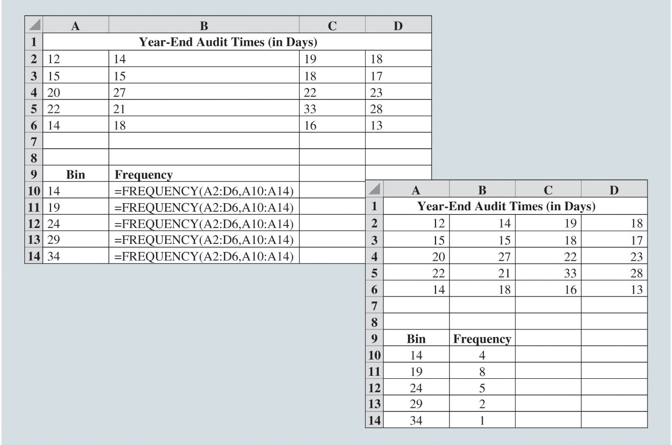
Creating Distributions from Data (Slide 10 of 18)
Figure 2.11: Using Excel to Generate a Frequency Distribution for Audit Times Data
Notes:
Figure 2.11 shows the data from Table 2.6 entered into an Excel Worksheet.
The sample of 20 audit times is contained in cells A2:D6.
The upper limits of the defined bins are in cells A10:A14.
We can use the FREQUENCY function in Excel to count the number of observations in each bin:
Step 1. Select cells B10:B14
Step 2. Enter the formula =FREQUENCY(A2:D6, A10:A14). The range A2:D6 defines the data set, and the range A10:A14 defines the bins
Step 3. Press CTRL+SHIFT+ENTER
Excel will then fill in the values for the number of observations in each bin in cells B10 through B14 because these were the cells selected in Step 1 above.

Slide 40
Creating Distributions from Data (Slide 11 of 18)
Histograms
Histogram: A common graphical presentation of quantitative data.
Constructed by placing the variable of interest on the horizontal axis and the selected frequency measure (absolute frequency, relative frequency, or percent frequency) on the vertical axis.
The frequency measure of each class is shown by drawing a rectangle whose base is the class limits on the horizontal axis and whose height is the corresponding frequency measure.

Slide 41
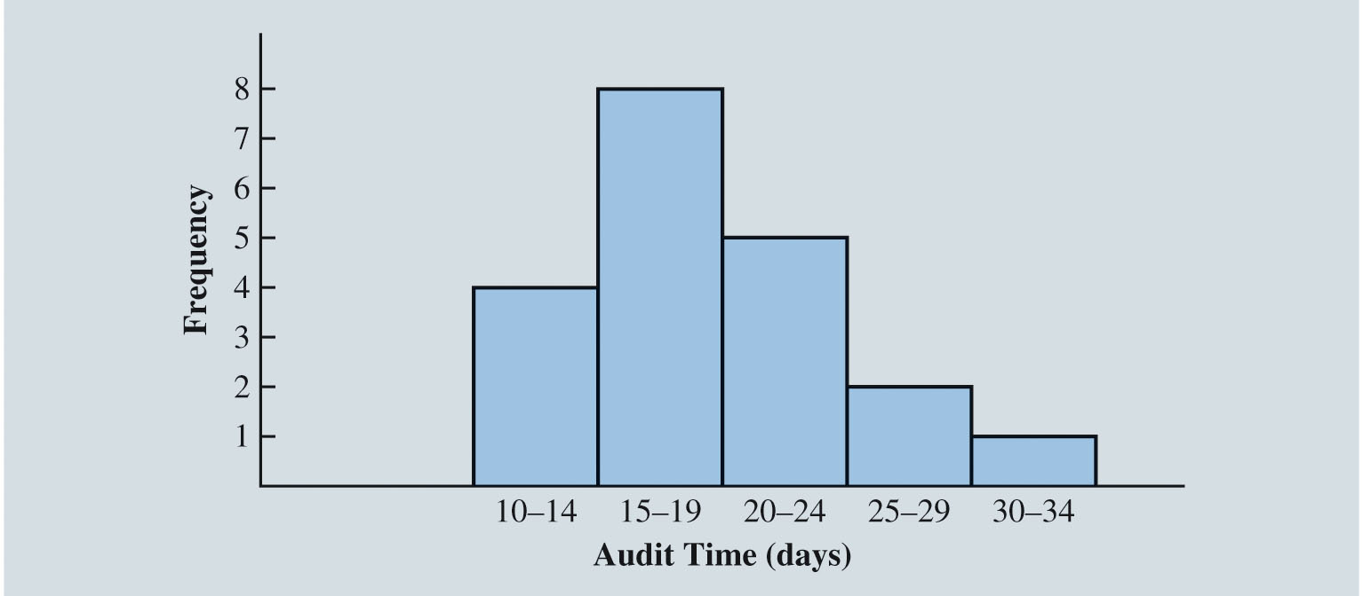
Creating Distributions from Data (Slide 12 of 18)
Figure 2.12: Histogram for the Audit Time Data
Notes:
In Figure 2.12, note that the class with the greatest frequency is shown by the rectangle appearing above the class of 15–19 days.
The height of the rectangle shows that the frequency of this class is 8.

Slide 42
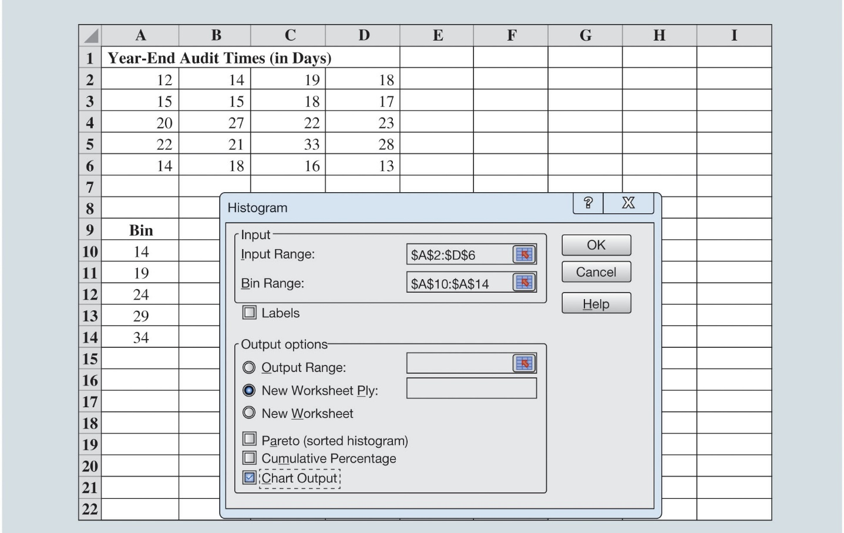
Creating Distributions from Data (Slide 13 of 18)
Figure 2.13: Creating a Histogram for the Audit Time Data Using Data Analysis Toolpak in Excel
Notes:
Histograms can be created in Excel using the Data Analysis ToolPak. Following are the steps to create histogram in Excel.
Step 1. Click the Data tab in the Ribbon
Step 2. Click Data Analysis in the Analyze group
Step 3. When the Data Analysis dialog box opens, choose Histogram from the list of Analysis Tools, and click OK
In the Input Range: box, enter A2:D6
In the Bin Range: box, enter A10:A14
Under Output Options:, select New Worksheet Ply:
Select the check box for Chart Output
Click OK

Slide 43
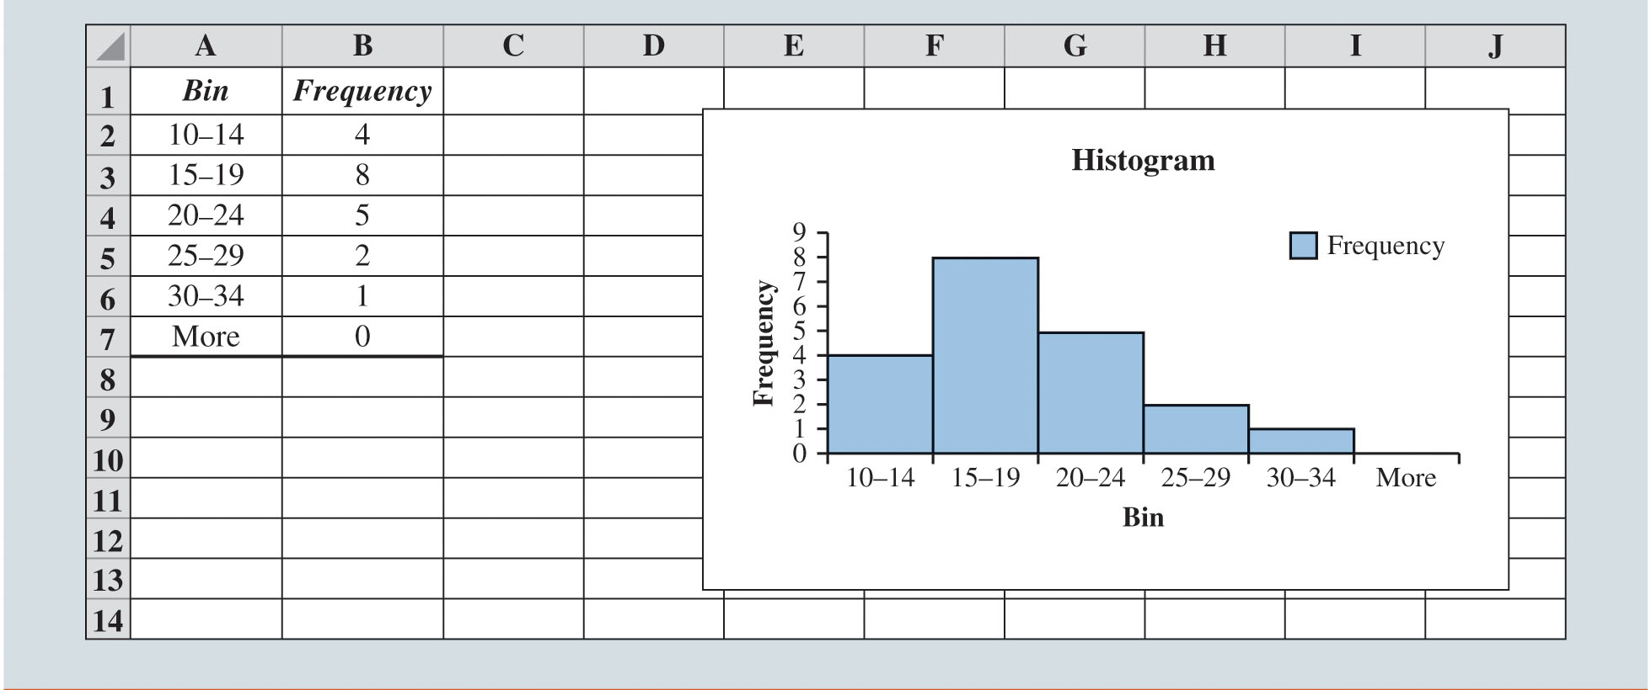
Creating Distributions from Data (Slide 14 of 18)
Figure 2.14: Completed Histogram for the Audit Time Data Using Data Analysis ToolPak in Excel
Notes:
In Figure 2.14, we have modified the bin ranges in column A by typing the values into cells A2:A6 so that the chart created by Excel shows both the lower and upper limits for each bin.
We have also removed the gaps between the columns in the histogram in Excel to match the traditional format of histograms.
To remove the gaps between the columns in the histogram created by Excel, follow these steps:
Step 1. Right-click on one of the columns in the histogram
Select Format Data Series…
Step 2. When the Format Data Series pane opens, click the Series Options button.
Set the Gap Width to 0%

Slide 44
Creating Distributions from Data (Slide 15 of 18)
Histograms (cont.)
Histograms provide information about the shape, or form, of a distribution.
Skewness: Lack of symmetry.
Skewness is an important characteristic of the shape of a distribution.

Slide 45
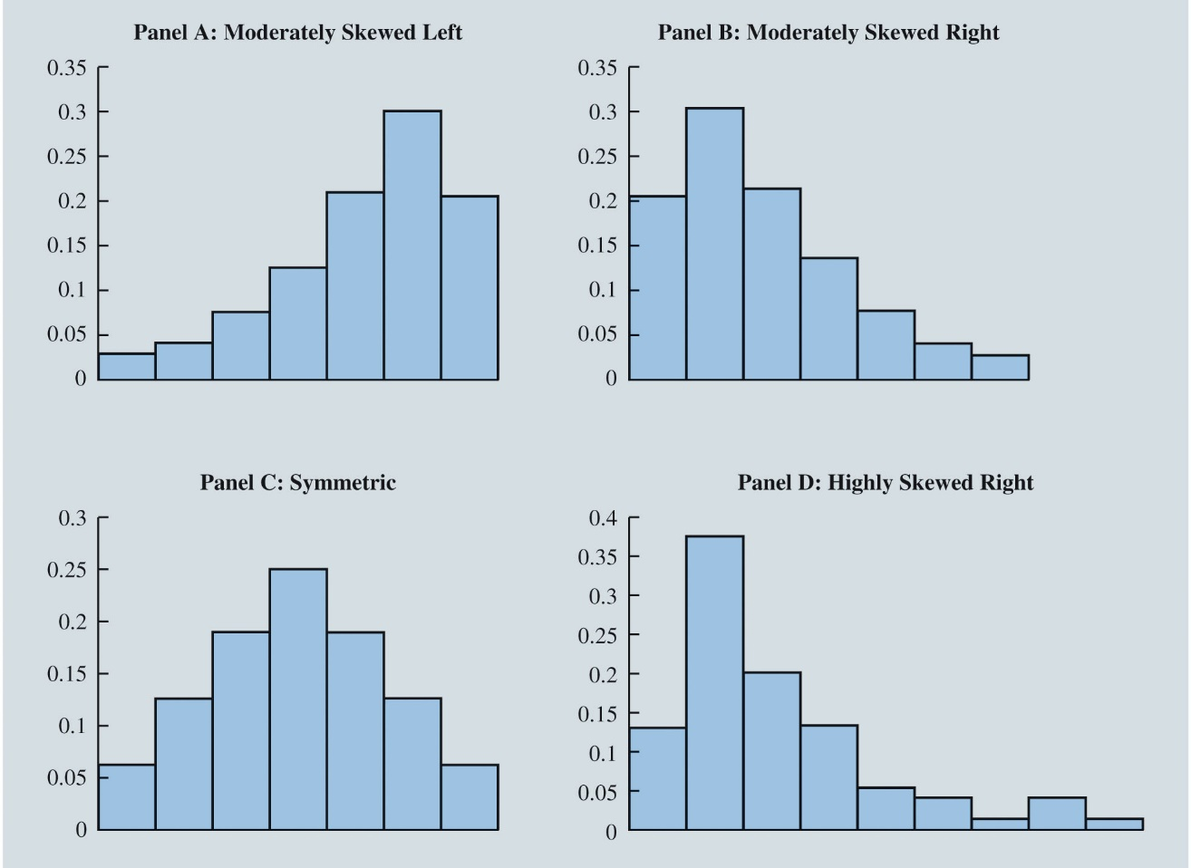
Creating Distributions from Data (Slide 16 of 18)
Figure 2.15: Histograms Showing Distributions with Different Levels of Skewness
Notes:
Panel A: Moderately skewed to the left:
Here, tail extends farther to the left than to the right.
Example: Exam scores, with no scores above 100%, most of the scores above 70%, and only a few really low scores.
Panel B: Moderately skewed to the right:
Tail extends farther to the right than to the left.
Example: Housing prices; a few expensive houses create the skewness in the right tail.
Panel C: Symmetric:
The left tail mirrors the shape of the right tail.
Example: Data for SAT scores, the heights and weights of people, and so on, lead to histograms that are roughly symmetric.
Panel D: Highly skewed to the right:
Example: Data on housing prices, salaries, purchase amounts, and so on, often result in histograms skewed to the right.

Slide 46
Creating Distributions from Data (Slide 17 of 18)
Cumulative Distributions
Cumulative frequency distribution: A variation of the frequency distribution that provides another tabular summary of quantitative data.
Uses the number of classes, class widths, and class limits developed for the frequency distribution.
Shows the number of data items with values less than or equal to the upper class limit of each class.

Slide 47
Creating Distributions from Data (Slide 18 of 18)
Table 2.8: Cumulative Frequency, Cumulative Relative Frequency, and Cumulative Percent Frequency Distributions for the Audit Time Data
Audit Time (days) | Cumulative Frequency | Cumulative Relative Frequency | Cumulative Percent Frequency
Less than or equal to 14 | 4 | 0.20 | 20
Less than or equal to 19 | 12 | 0.60 | 60
Less than or equal to 24 | 17 | 0.85 | 85
Less than or equal to 29 | 19 | 0.95 | 95
Less than or equal to 34 | 20 | 1.00 | 100
Notes:
Consider the class with the description “Less than or equal to 24.”
The cumulative frequency for this class is simply the sum of the frequencies for all classes with data values less than or equal to 24.
The sum of the frequencies for classes 10–14, 15–19, and 20–24 indicates that 4 + 8 + 5 = 17 data values are less than or equal to 24. Hence, the cumulative frequency for this class is 17.
In addition, the cumulative frequency distribution in Table 2.8 shows that four audits were completed in 14 days or less and that 19 audits were completed in 29 days or less.
The cumulative relative frequency distribution can be computed either by summing the relative frequencies in the relative frequency distribution or by dividing the cumulative frequencies by the total number of items.
Using the latter approach, we found the cumulative relative frequencies in column 3 of Table 2.8 by dividing the cumulative frequencies in column 2 by the total number of items (n = 20).
The cumulative percent frequencies were again computed by multiplying the relative frequencies by 100.
The cumulative relative and percent frequency distributions show that 0.85 of the audits, or 85%, were completed in 24 days or less, 0.95 of the audits, or 95%, were completed in 29 days or less, and so on.

Slide 48
Measures of Location
Mean (Arithmetic Mean)
Median
Mode
Geometric Mean

Slide 49
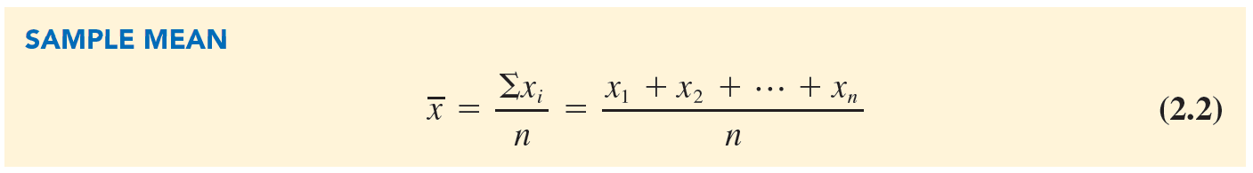
Measures of Location (Slide 1 of 13)
Mean/Arithmetic Mean
Average value for a variable.
The mean is denoted by
n = sample size.
= value of variable x for the first observation.
= value of variable x for the second observation.
= value of variable x for the ith observation.
Notes:
Arithmetic Mean:
Provides a measure of central location for the data.
Denoted by $\overline{x}$for sample data.
Denoted by µ for population data.

Slide 50
Measures of Location (Slide 2 of 13)
Table 2.9: Data on Home Sales in a Cincinnati, Ohio, Suburb
Home Sale | Selling Price ($)
1 | 138,000
2 | 254,000
3 | 186,000
4 | 257,500
5 | 108,000
6 | 254,000
7 | 138,000
8 | 298,000
9 | 199,500
10 | 208,000
11 | 142,000
12 | 456,250

Slide 51
Measures of Location (Slide 3 of 13)
Computation of Sample Mean:
Illustration: Computation of the mean home selling price for the sample of 12 home sales.

Slide 52
Measures of Location (Slide 4 of 13)
Median
Median: Value in the middle when the data are arranged in ascending order.
Middle value, for an odd number of observations.
Average of two middle values, for an even number of observations.

Slide 53
Measures of Location (Slide 5 of 13)
Computation of Sample Median
Illustration: When the number of observations are odd,
Consider the class size data for a sample of five college classes:
46 54 42 46 32
Arrange the class size data in ascending order:
32 42 46 46 54
Middlemost value in the data set = 46.
Median is 46.
Notes:
Because n = 5 is odd, median is the middlemost value in the data set, 46.

Slide 54
Measures of Location (Slide 6 of 13)
Computation of Sample Median
Illustration: When the number of observations are even:
Consider the data on home sales in Cincinnati, Ohio, Suburb (Table 2.9).
Arrange the data in ascending order:
108,000 138,000 138,000 142,000 186,000 199,500 208,000 254,000 254,000 257,500 298,000 456,250
Median = average of two middle values:

Slide 55
Measures of Location (Slide 7 of 13)
Mode
Mode: Value that occurs most frequently in a data set.
Consider the class size data:
32 42 46 46 54
Observe: 46 is the only value that occurs more than once.
Mode is 46.
Multimodal data: Data contain at least two modes.
Bimodal data: Data contain exactly two modes.

Slide 56
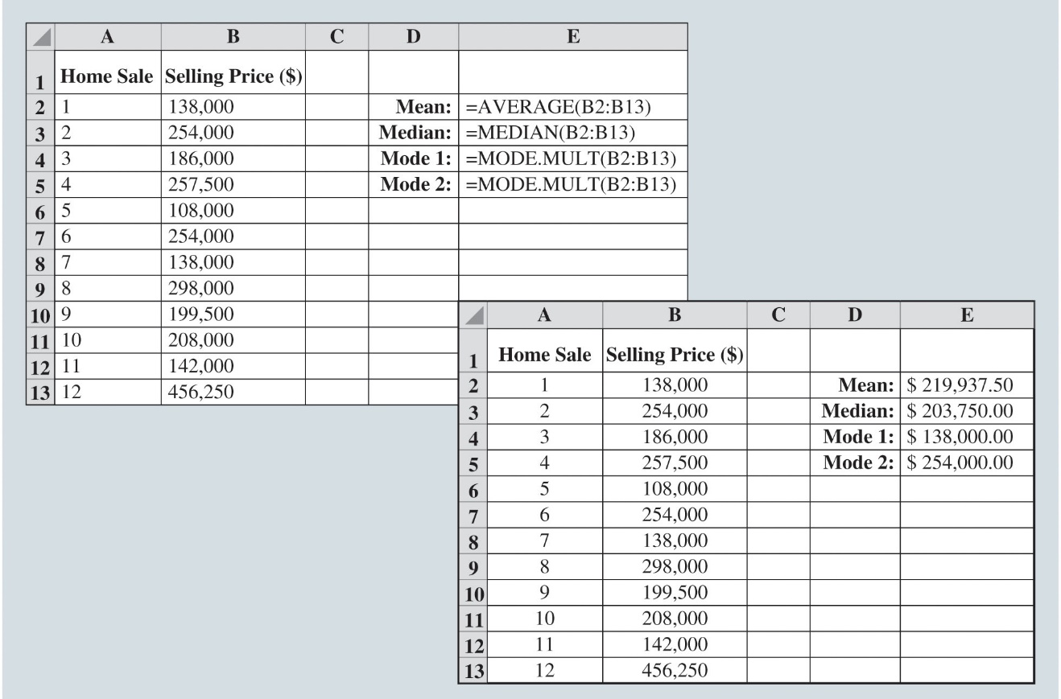
Measures of Location (Slide 8 of 13)
Figure 2.16: Calculating the Mean, Median, and Modes for the Home Sales Data Using Excel
Notes:
The mean can be found in Excel using the AVERAGE function. The value for the mean in cell E2 is calculated using the formula =AVERAGE(B2:B13).
The median of a data set can be found in Excel using the function MEDIAN. The value for the median in cell E3 is found using the formula =MEDIAN(B2:B13).
The Excel MODE.SNGL function will return only a single most-often-occurring value.
For multimodal distributions, we must use the MODE.MULT command in Excel to return more than one mode.
To find both of the modes in Excel, we take these steps:
Step 1. Select cells E4 and E5
Step 2. Enter the formula =MODE.MULT(B2:B13)
Step 3. Press CTRL+SHIFT+ENTER
Excel enters the values for both modes of this data set in cells E4 and E5: $138,000 and $254,000.

Slide 57
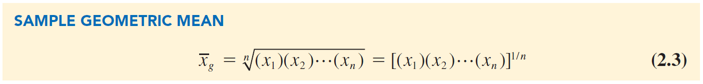
Measures of Location (Slide 9 of 13)
Geometric Mean:
Geometric mean: A measure of location that is calculated by finding the nth root of the product of n values
Used in analyzing growth rates in financial data.
Sample geometric mean:

Slide 58
Measures of Location (Slide 10 of 13)
Table 2.10: Percentage Annual Returns and Growth Factors for the Mutual Fund Data
Illustration: Consider the percentage annual returns and growth factors for the mutual fund data over the past 10 years.
We will determine the mean rate of growth for the fund over the 10-year period.

Slide 59
Measures of Location (Slide 11 of 13)
Table 2.10: Percentage Annual Returns and Growth Factors for the Mutual Fund Data (cont.)
Year | Return (%) | Growth Factor
1 | −22.1 | 0.779
2 | 28.7 | 1.287
3 | 10.9 | 1.109
4 | 4.9 | 1.049
5 | 15.8 | 1.158
6 | 5.5 | 1.055
7 | −37.0 | 0.630
8 | 26.5 | 1.265
9 | 15.1 | 1.151
10 | 2.1 | 1.021

Slide 60
Measures of Location (Slide 12 of 13)
Computation of Geometric Mean
Solution:
Product of the growth factors:
Geometric mean of the growth factors:
Conclude that annual returns grew at an average annual rate of

Slide 61
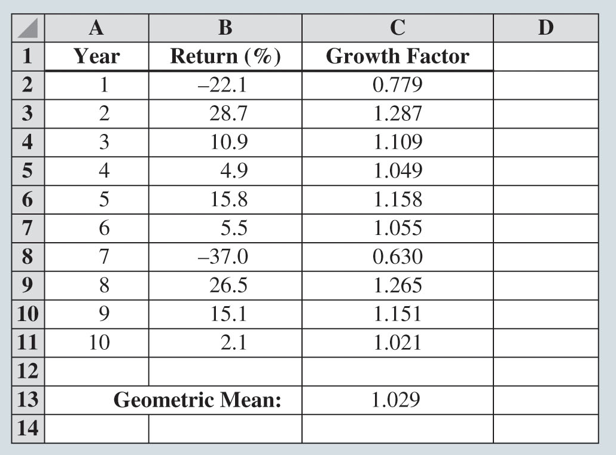
Measures of Location (Slide 13 of 13)
Figure 2.17: Calculating the Geometric Mean for the Mutual Fund Data Using Excel
Notes:
In Figure 2.17, the value for the geometric mean in cell C13 is found using the formula =GEOMEAN(C2:C11).

Slide 62
Measures of Variability
Range
Variance
Standard Deviation
Coefficient of Variation

Slide 63
Measures of Variability (Slide 1 of 10)
Table 2.11: Annual Payouts for Two Different Investment Funds
Year | Fund A ($) | Fund B ($)
1 | 1,100 | 700
2 | 1,100 | 2,500
3 | 1,100 | 1,200
4 | 1,100 | 1,550
5 | 1,100 | 1,300
6 | 1,100 | 800
7 | 1,100 | 300
8 | 1,100 | 1,600
9 | 1,100 | 1,500
10 | 1,100 | 350
11 | 1,100 | 460

Slide 64
Measures of Variability (Slide 2 of 10)
Table 2.11: Annual Payouts for Two Different Investment Funds (cont.)
Year | Fund A ($) | Fund B ($)
12 | 1,100 | 890
13 | 1,100 | 1,050
14 | 1,100 | 800
15 | 1,100 | 1,150
16 | 1,100 | 1,200
17 | 1,100 | 1,800
18 | 1,100 | 100
19 | 1,100 | 1,750
20 | 1,100 | 1,000
Mean | 1,100 | 1,100

Slide 65
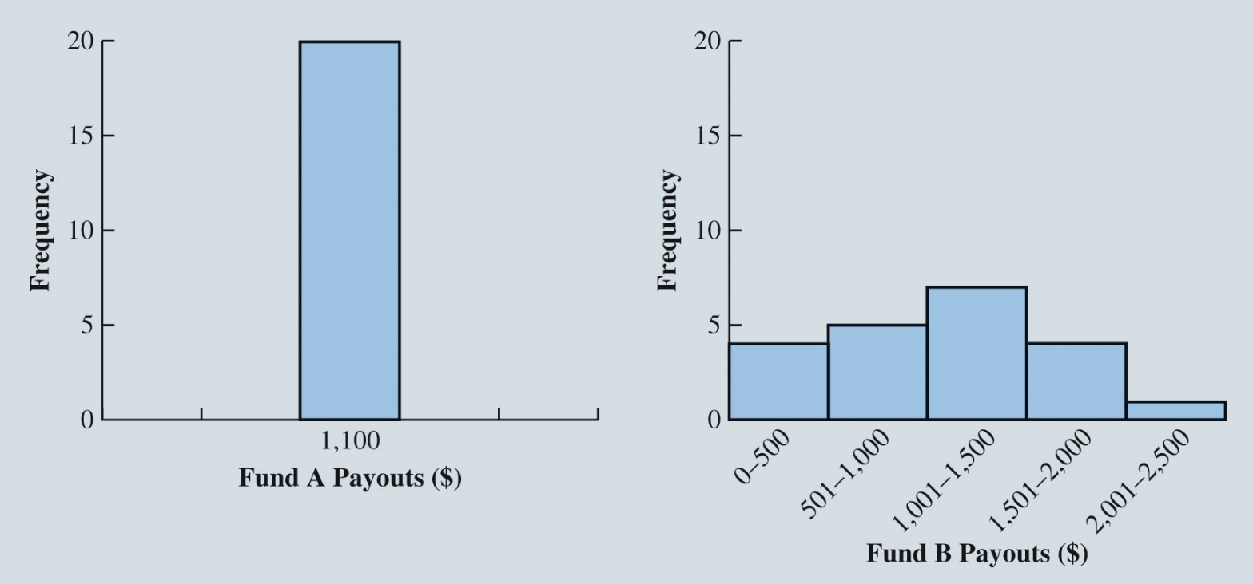
Measures of Variability (Slide 3 of 10)
Figure 2.18: Histograms for Payouts of Past 20 Years from Fund A and Fund B

Slide 66
Measures of Variability (Slide 4 of 10)
Computation of Range
Range:
The range can be found by subtracting the smallest value from the largest value in a data set.
Illustration: Consider the data on home sales in a Cincinnati, Ohio, suburb.
Largest home sales price: $456,250.
Smallest home sales price: $108,000.
Drawback: Range is based on only two of the observations and thus is highly influenced by extreme values.

Slide 67
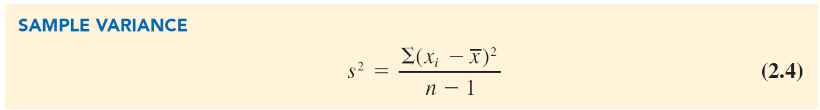
Measures of Variability (Slide 5 of 10)
Variance
Variance is a measure of variability that utilizes all the data.
It is based on the deviation about the mean, which is the difference between the value of each observation (x_{i}) and the mean.
The deviations about the mean are squared while computing the variance.
Population variance:

Slide 68
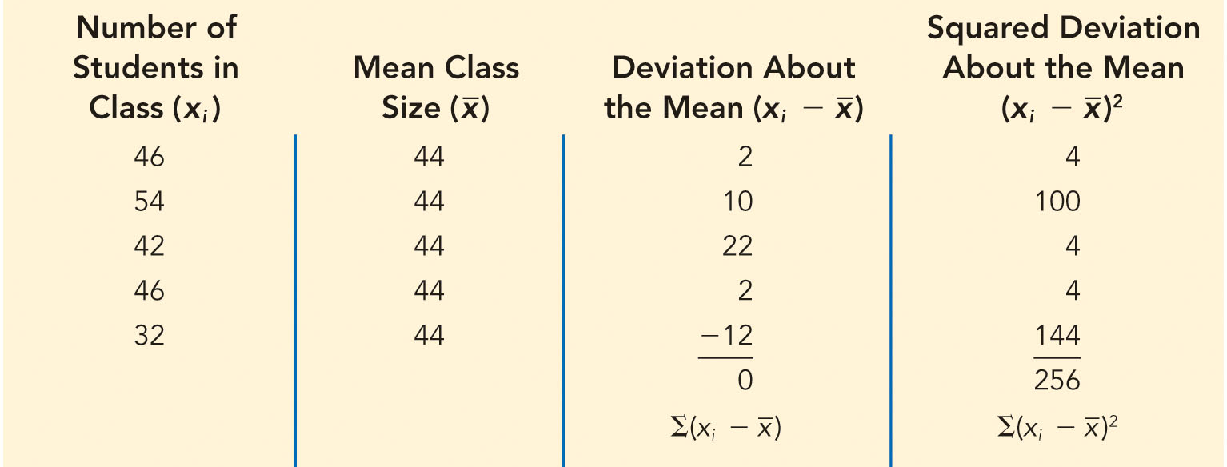
Measures of Variability (Slide 6 of 10)
Table 2.12: Computation of Deviations and Squared Deviations About the Mean for the Class Size Data
Computation of Sample Variance:

Slide 69
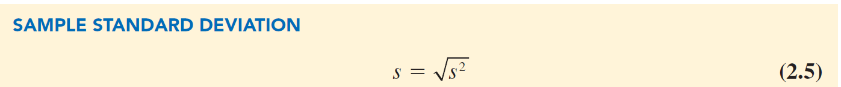
Measures of Variability (Slide 7 of 10)
Standard Deviation
Standard deviation is the positive square root of the variance.
Measured in the same units as the original data.
For population,

Slide 70
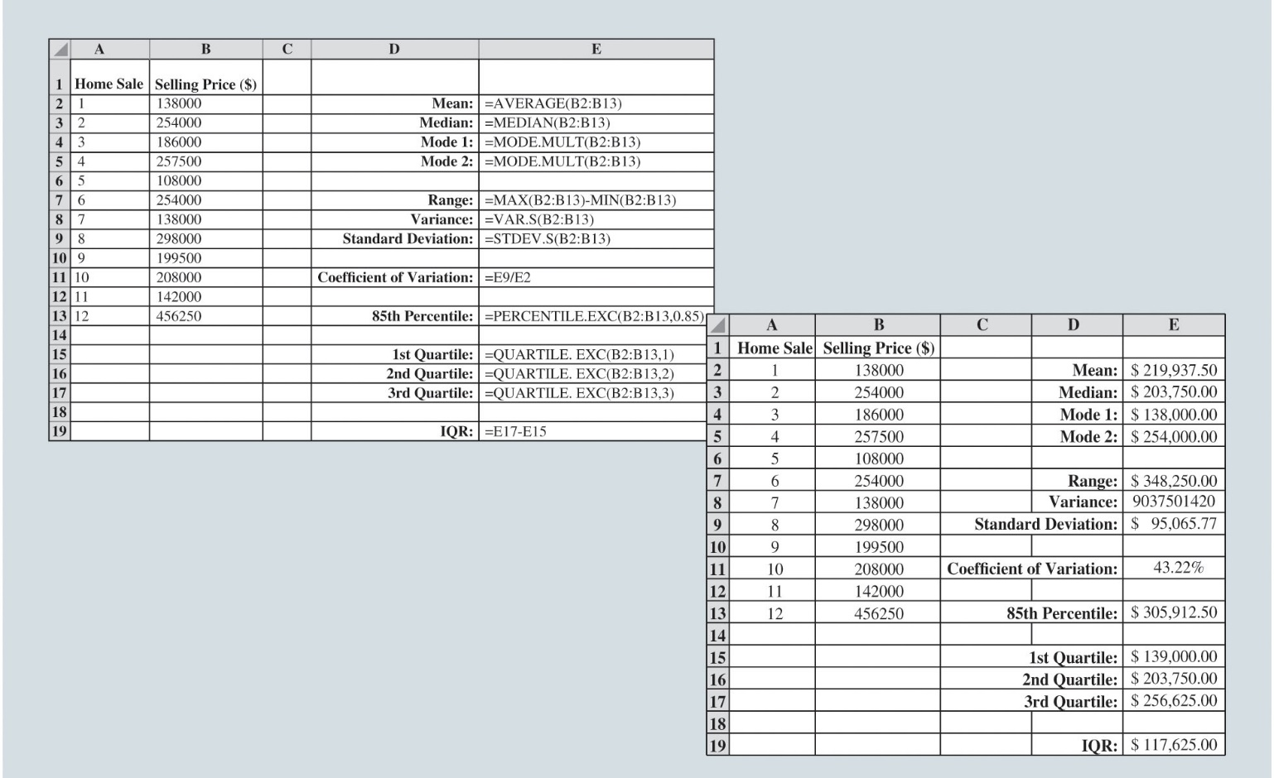
Measures of Variability (Slide 8 of 10)
Figure 2.19: Calculating Variability Measures for the Home Sales Data in Excel
Notes:
Calculating the variability measures in Excel:
Range:
The range can be calculated in Excel using the MAX and MIN functions.
The range value in cell E7 of Figure 2.19 calculates the range using the formula =MAX(B2:B13) - MIN(B2:B13).
This subtracts the smallest value in the range B2:B13 from the largest value in the range B2:B13.
Variance:
The variance in cell E8 is calculated using the formula =VAR.S(B2:B13).
Excel calculates the variance of the sample of 12 home sales to be 9,037,501,420.
Standard deviation:
The sample standard deviation in cell E9 is calculated using the formula =STDEV.S(B2:B13).
Excel calculates the sample standard deviation for the home sales to be $95,065.77.
Coefficient of Variation:
It is calculated in cell E11 using the formula =E9/E2, which divides the standard deviation by the mean. The coefficient of variation for the home sales data is 43.22%.

Slide 71
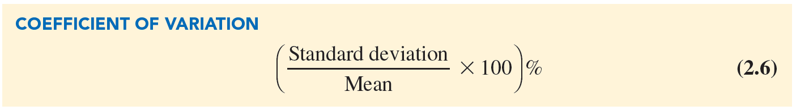
Measures of Variability (Slide 9 of 10)
Coefficient of Variation
The coefficient of variation is a descriptive statistic that indicates how large the standard deviation is relative to the mean.
Expressed as a percentage.

Slide 72
Measures of Variability (Slide 10 of 10)
Computation of Coefficient of Variation
Illustration:
Consider the class size data:
46 54 42 46 32
Mean,
Standard deviation,
Coefficient of variation =
Notes:
The coefficient of variation tells that the sample standard deviation is 18.2% of the value of the sample mean.

Slide 73
Analyzing Distributions
Percentiles
Quartiles
z-Scores
Empirical Rule
Identifying Outliers
Box Plots

Slide 74
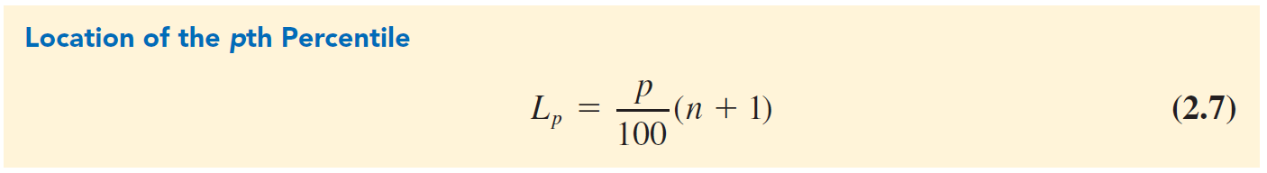
Analyzing Distributions (Slide 1 of 15)
Percentiles
A percentile is the value of a variable at which a specified (approximate) percentage of observations are below that value.
The pth percentile tells us the point in the data where:
Approximately p percent of the observations have values less than the pth percentile.
Approximately
percent of the observations have values greater than the pth percentile.

Slide 75
Analyzing Distributions (Slide 2 of 15)
Illustration
To determine the 85th percentile for the home sales data in Table 2.9:
Arrange the data in ascending order:
108,000 138,000 138,000 142,000 186,000 199,500 208,000 254,000 254,000 257,500 298,000 456,250
Compute
The interpretation of
is that the 85th percentile is 5 percent of the way between the value in position 11 and value in position 12.

Slide 76
Analyzing Distributions (Slide 3 of 15)
Illustration (cont.):
To determine the 85th percentile for the home sales data in Table 2.9.
The value in the 11th position is 298,000.
The value in the 12th position is 456,250.
$305,912.50 represents the 85th percentile of the home sales data:

Slide 77
Analyzing Distributions (Slide 4 of 15)
Quartiles
Quartiles: When the data is divided into four equal parts:
Each part contains approximately 25% of the observations.
Division points are referred to as quartiles.
The difference between the third and first quartiles is often referred to as the interquartile range, or IQR.

Slide 78
Analyzing Distributions (Slide 5 of 15)
z-Scores
The z-score measures the relative location of a value in the data set.
Helps to determine how far a particular value is from the mean relative to the data set’s standard deviation.
Often called the standardized value.
Notes:
The z -score can be interpreted as the number of standard deviations $x_{i}$ is from the mean $\overline{x}$.

Slide 79
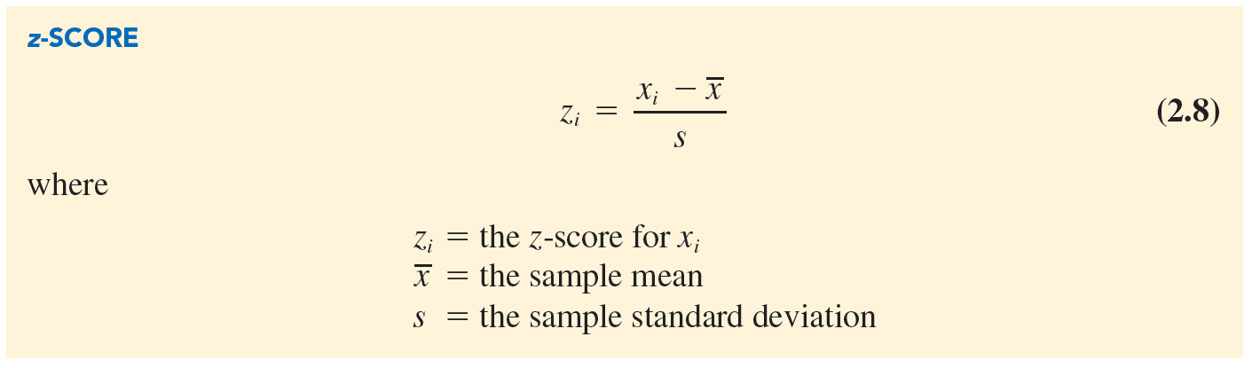
Analyzing Distributions (Slide 6 of 15)
z-Scores (cont.)
If
Notes:
The z -score can be interpreted as the number of standard deviations $x_{i}$ is from the mean $\overline{x}$.

Slide 80
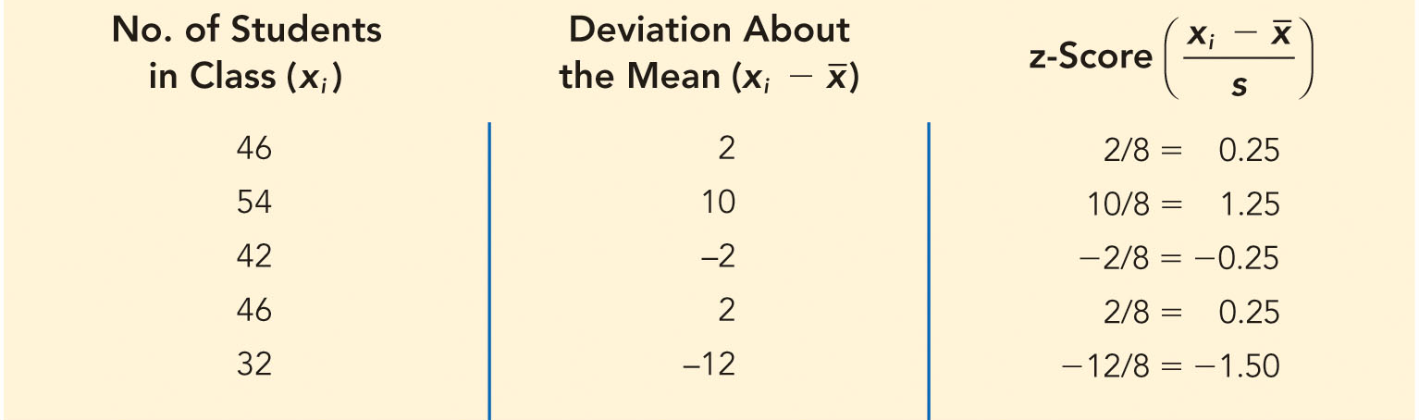
Analyzing Distributions (Slide 7 of 15)
Table 2.13: z-Scores for the Class Size Data
For class size data,
For observations with a value
For observations with a value
Notes:
$z_{1}$ = 0.25 would indicate that $x_{1}$ is 0.25 standard deviations greater than the sample mean.

Slide 81
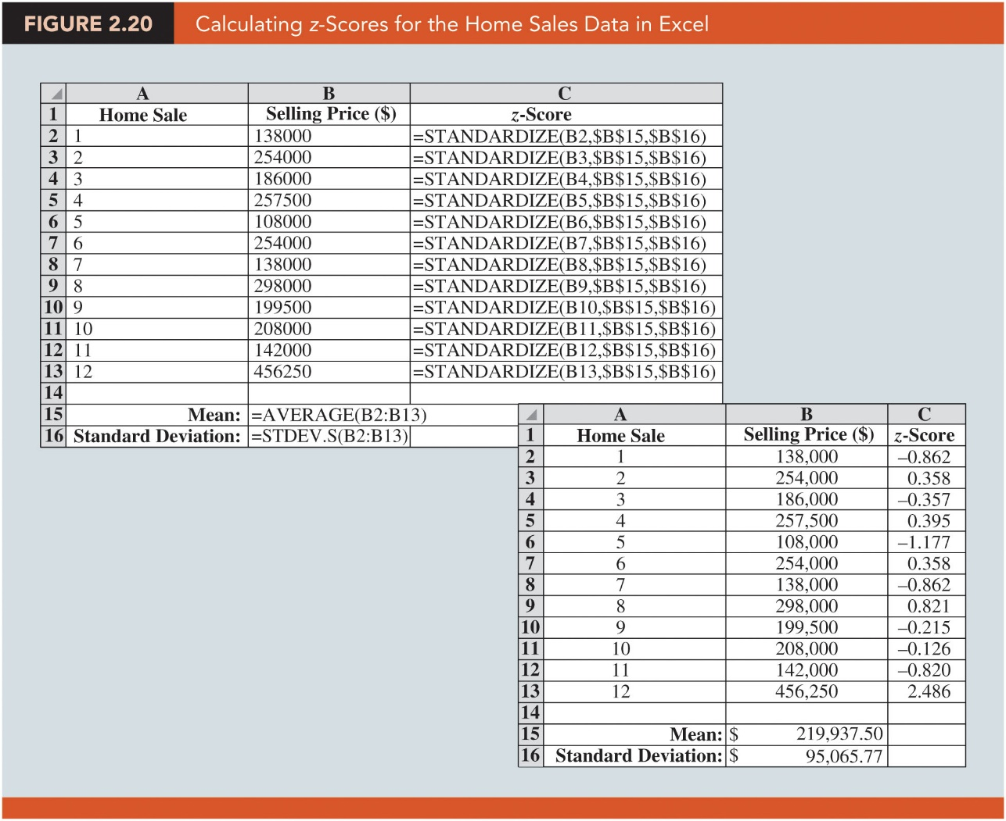
Analyzing Distributions (Slide 8 of 15)
Figure 2.20: Calculating z-Scores for the Home Sales Data in Excel
Notes:
To calculate the z-scores, the mean and standard deviation for the data set must be provided in the arguments of the STANDARDIZE function.
For instance, the z-score in cell C2 is calculated with the formula =STANDARDIZE(B2, $B$15, $B$16), where cell B15 contains the mean of the home sales data and cell B16 contains the standard deviation of the home sales data.
Then, this formula can be copied and pasted into cells C3:C13.

Slide 82
Analyzing Distributions (Slide 9 of 15)
Empirical Rule
When the distribution of data exhibits a symmetric bell-shaped distribution (as shown in Figure 2.21), the empirical rule can be used to determine the percentage of data values that are within a specified number of standard deviations of the mean.
For data having a bell-shaped distribution,
Approximately 68 percent of the data values will be within 1 standard deviation.
Approximately 95 percent of the data values will be within 2 standard deviations.
Almost all the data values will be within 3 standard deviations.
Notes:
Empirical rule:
The height of adult males in the United States has a bell-shaped distribution with a mean of approximately 69.5 inches and standard deviation of approximately 3 inches.
Using the empirical rule, the following conclusions can be drawn.
Approximately 68% of adult males in the United States have heights between 69.5 – 3 = 66.5 and 69.5 + 3 = 72.5 inches.
Approximately 95% of adult males in the United States have heights between 63.5 and 75.5 inches.
Almost all adult males in the United States have heights between 60.5 and 78.5 inches.

Slide 83
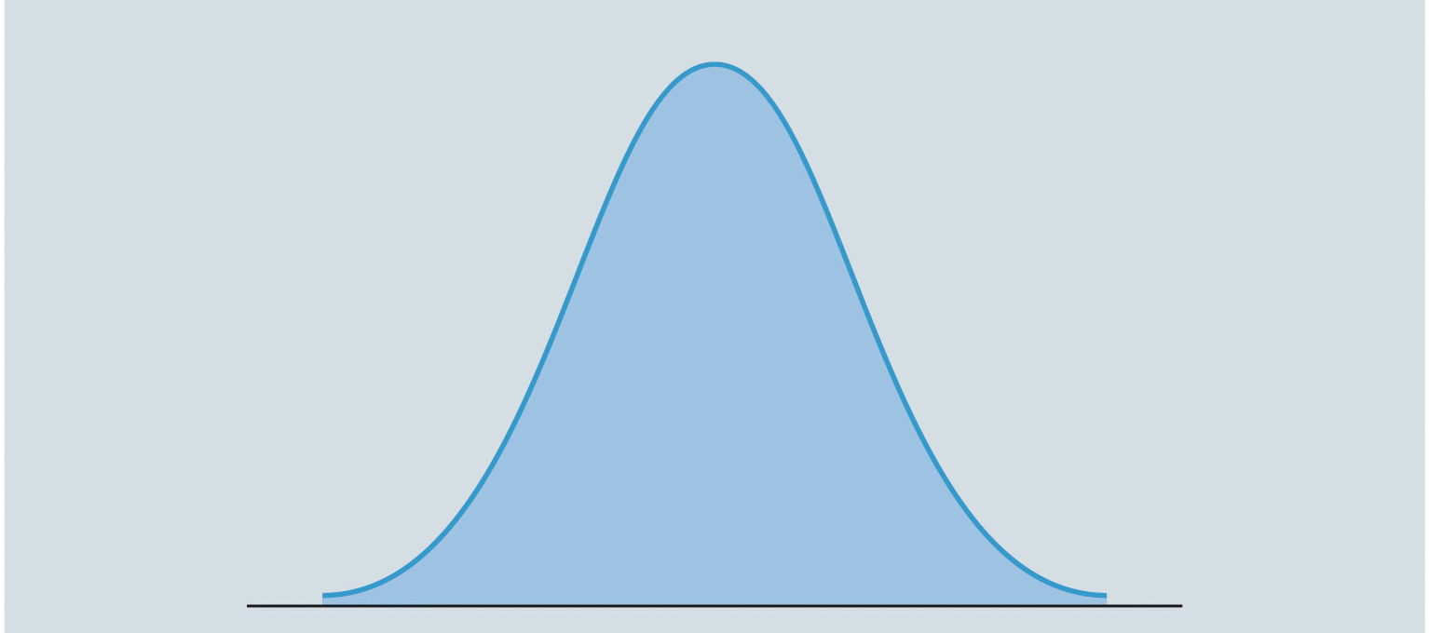
Analyzing Distributions (Slide 10 of 15)
Figure 2.21: A Symmetric Bell-Shaped Distribution

Slide 84
Analyzing Distributions (Slide 11 of 15)
Identifying Outliers
Outliers: Extreme values in a data set.
They can be identified using standardized values (z-scores).
Any data value with a z-score less than –3 or greater than +3 is an outlier.
Such data values can then be reviewed to determine their accuracy and whether they belong in the data set.
Notes:
Outliers:
An outlier may be a data value that has been incorrectly recorded; if so, it can be corrected before further analysis.
It may also be from an observation that doesn’t belong to the population we are studying and was incorrectly included in the data set; if so, it can be removed.
It may be an unusual data value that has been recorded correctly and is a member of the population we are studying. In such cases, the observation should remain.

Slide 85
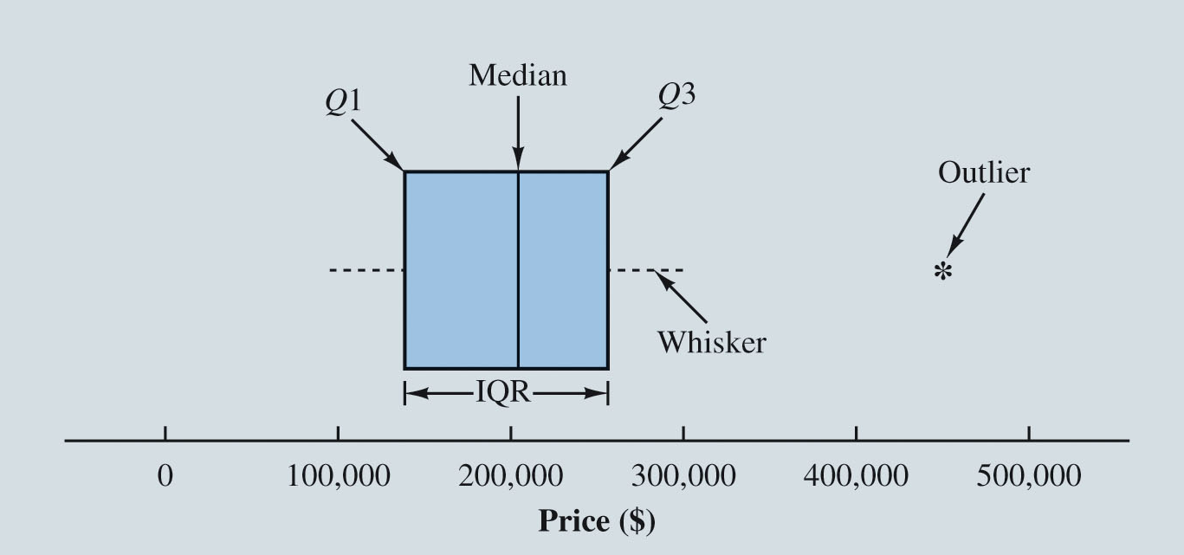
Analyzing Distributions (Slide 12 of 15)
Box Plots
A box plot is a graphical summary of the distribution of data.
Developed from the quartiles for a data set.
Figure 2.22: Box Plot for the Home Sales Data
Notes:
Steps used to construct the box plot for the home sales data:
A box is drawn with the ends of the box located at the first and third quartiles. For the home sales data, Q1 = 139,000 and Q3 = 256,625. This box contains the middle 50% of the data.
A vertical line is drawn in the box at the location of the median (203,750 for the home sales data).
By using the interquartile range, IQR = Q₃ – Q₁, limits are located. The limits for the box plot are 1.5(IQR) below Q1 and 1.5(IQR) above Q3. For the home sales data, IQR = Q₃ – Q₁ = 256,625 – 139,000 = 117,625. Thus, the limits are 139,000 – 1.5(117,625) = –37,437.5 and 256,625 + 1.5(117,625) = 433,062.5. Data outside these limits are considered outliers.
The dashed lines in Figure 2.22 are called whiskers. The whiskers are drawn from the ends of the box to the smallest and largest values inside the limits computed in Step 3. Thus, the whiskers end at home sales values of 108,000 and 298,000.
Finally, the location of each outlier is shown with an asterisk (*). In Figure 2.22, we see one outlier, 456,250.

Slide 86
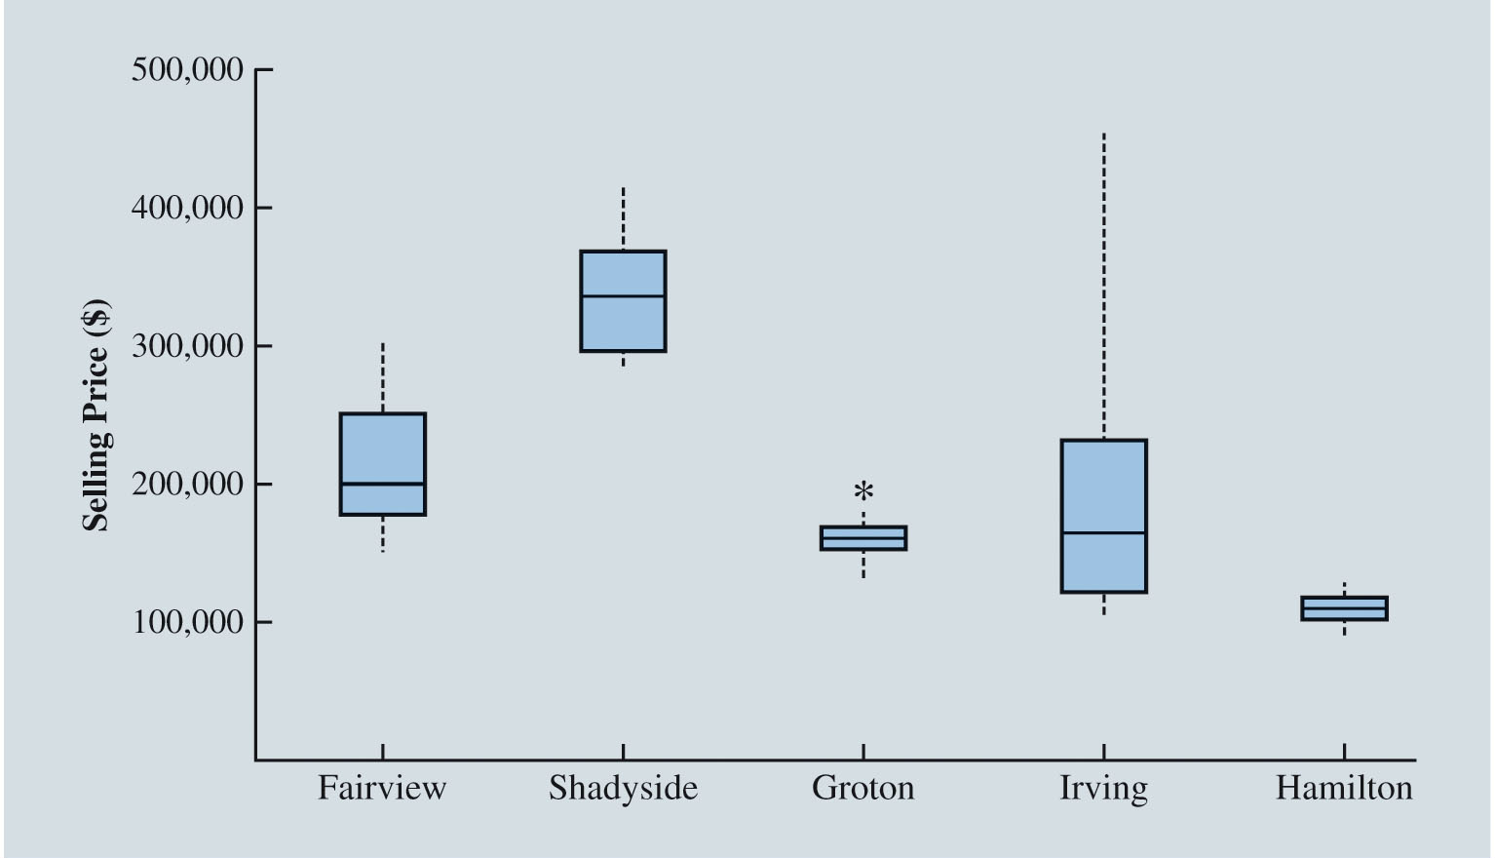
Analyzing Distributions (Slide 13 of 15)
Figure 2.23: Box Plots Comparing Home Sale Prices in Different Communities
Notes:
To compare home sales from several different communities, we have created box plots for recent home sales in each community.
The most expensive houses appear to be in Shadyside and the cheapest houses in Hamilton.
The median home selling price in Groton is about the same as the median home selling price in Irving. However, home sales prices in Irving have much greater variability.
Homes appear to be selling in Irving for many different prices, from very low to very high.
Home selling prices have the least variation in Groton and Hamilton.
Groton is the only location considered an outlier, but note that most homes sell for very similar prices in Groton, so the selling price does not have to be too far from the median to be considered an outlier.

Slide 87
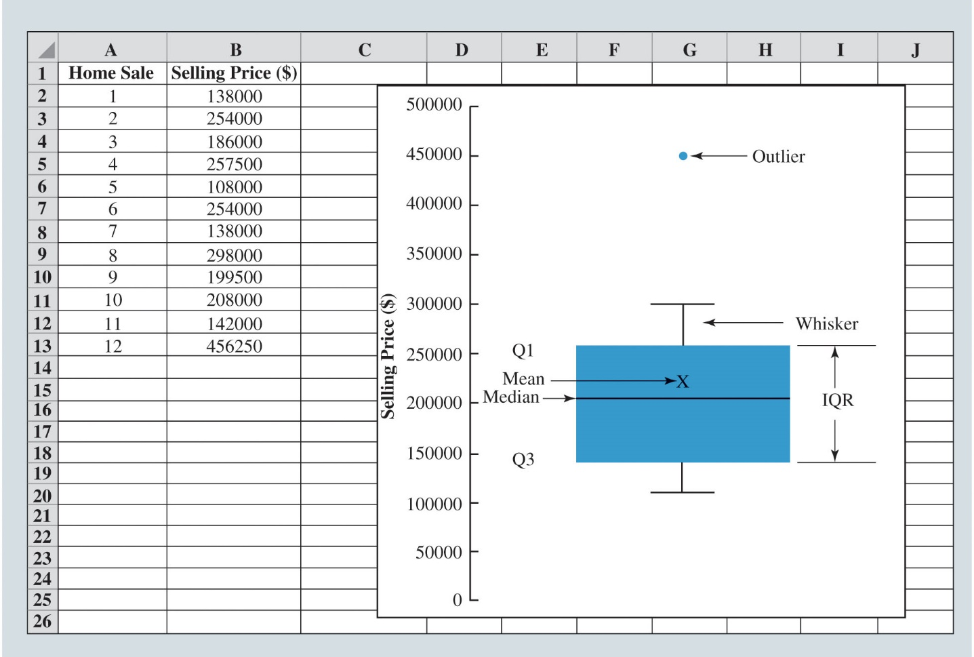
Analyzing Distributions (Slide 14 of 15)
Figure 2.24: Box Plot Created in Excel for Home Sales Data

Slide 88
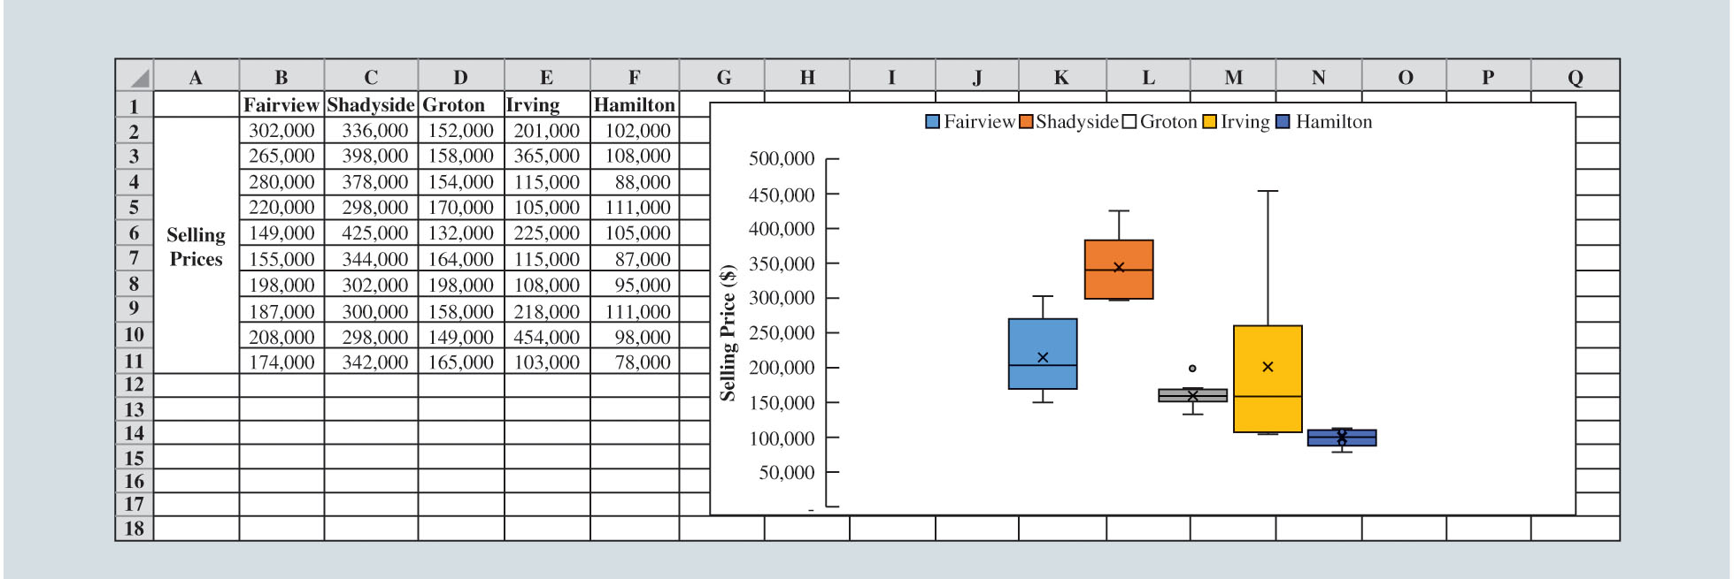
Analyzing Distributions (Slide 15 of 15)
Figure 2.25: Box Plots for Multiple Variables Created in Excel

Slide 89
Measures of Association between Two Variables
Scatter Charts
Covariance
Correlation Coefficient

Slide 90
Measures of Association between Two Variables (Slide 1 of 11)
High Temperature (°F) | Bottled Water Sales (cases)
78 | 23
79 | 22
80 | 24
80 | 22
82 | 24
83 | 26
85 | 27
86 | 25
87 | 28
87 | 26
88 | 29
88 | 30
90 | 31
92 | 31
Table 2.14: Data for Bottled Water Sales at Queensland Amusement Park for a Sample of 14 Summer Days

Slide 91
Measures of Association between Two Variables (Slide 2 of 11)
Scatter Charts
A scatter chart is a useful graph for analyzing the relationship between two variables.
The scatter chart in Figure 2.26 is an example of a positive relationship because when one variable (high temperature) increases, the other variable (sales of bottled water) generally also increases.
The scatter chart also suggests that a straight line could be used as an approximation for the relationship between high temperature and sales of bottled water.

Slide 92
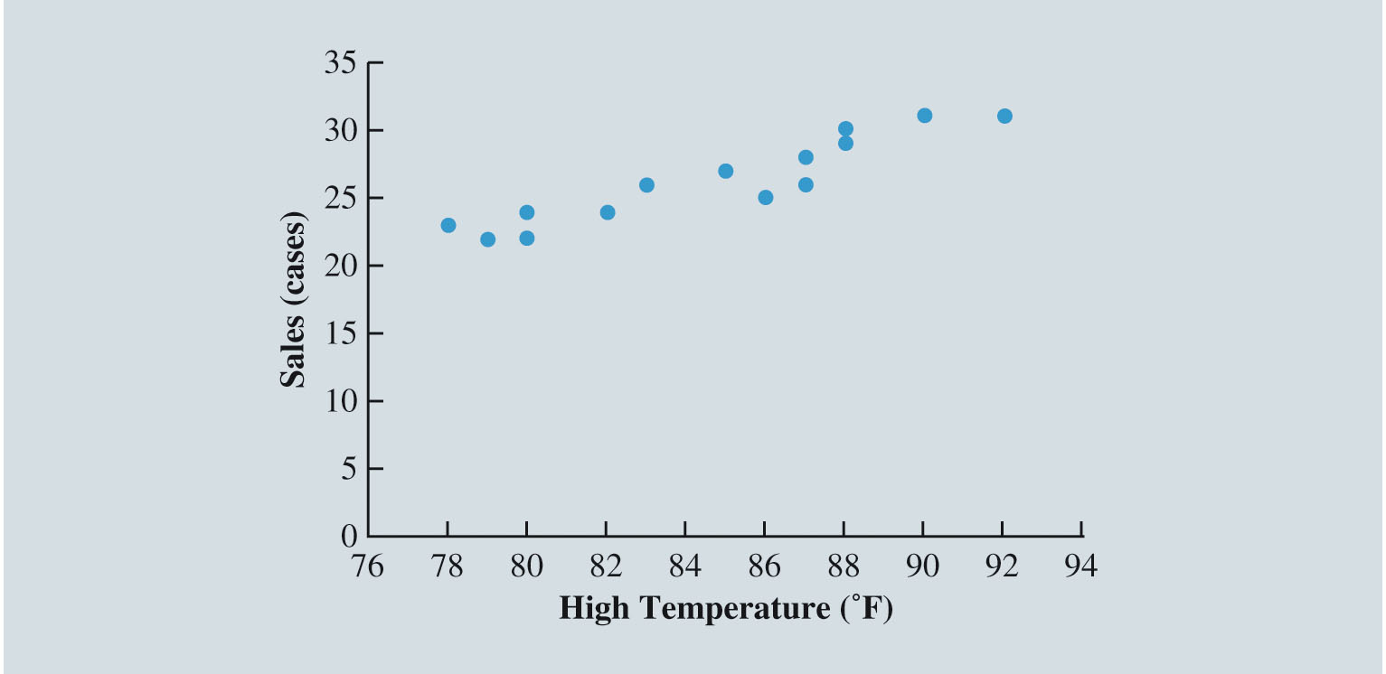
Measures of Association between Two Variables (Slide 3 of 11)
Figure 2.26: Chart Showing the Positive Linear Relation between Sales and High Temperatures

Slide 93
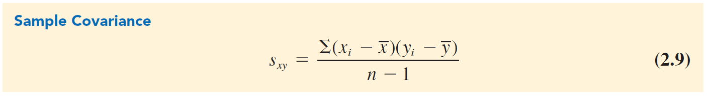
Measures of Association between Two Variables (Slide 4 of 11)
Covariance:
Covariance is a descriptive measure of the linear association between two variables:
Population covariance,

Slide 94
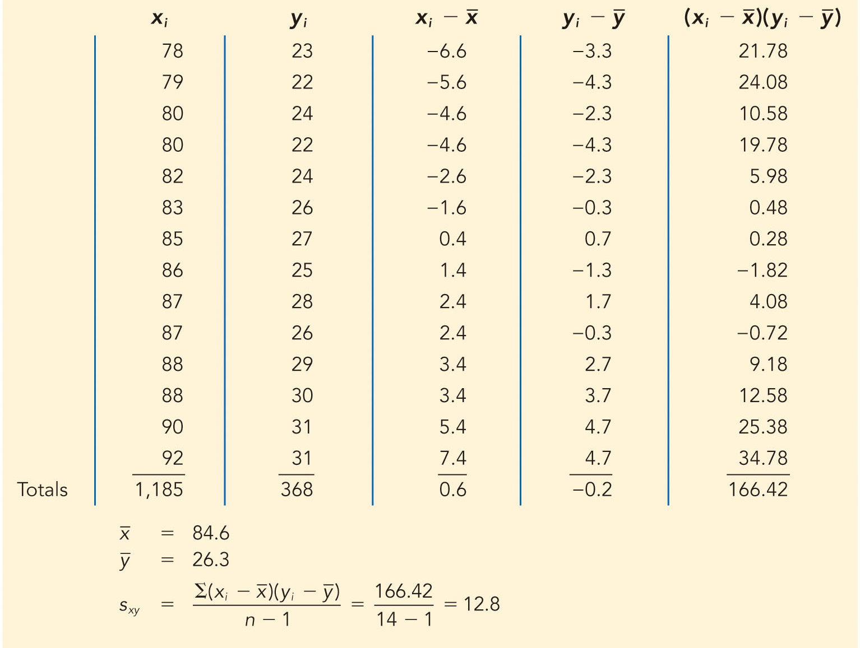
Measures of Association between Two Variables (Slide 5 of 11)
Table 2.15: Sample Covariance Calculations for Daily High Temperature and Bottled Water Sales at Queensland Amusement Park
Notes:
Because the covariance is greater than 0, it indicates a positive relationship between the high temperature and sales of bottled water.
This verifies the relationship in the scatter chart in Figure 2.26 that as the high temperature for a day increases, sales of bottled water generally increase.
If the covariance is near 0, then the x and y variables are not linearly related.
If the covariance is less than 0, then the x and y variables are negatively related, which means that as x increases, y generally decreases.

Slide 95
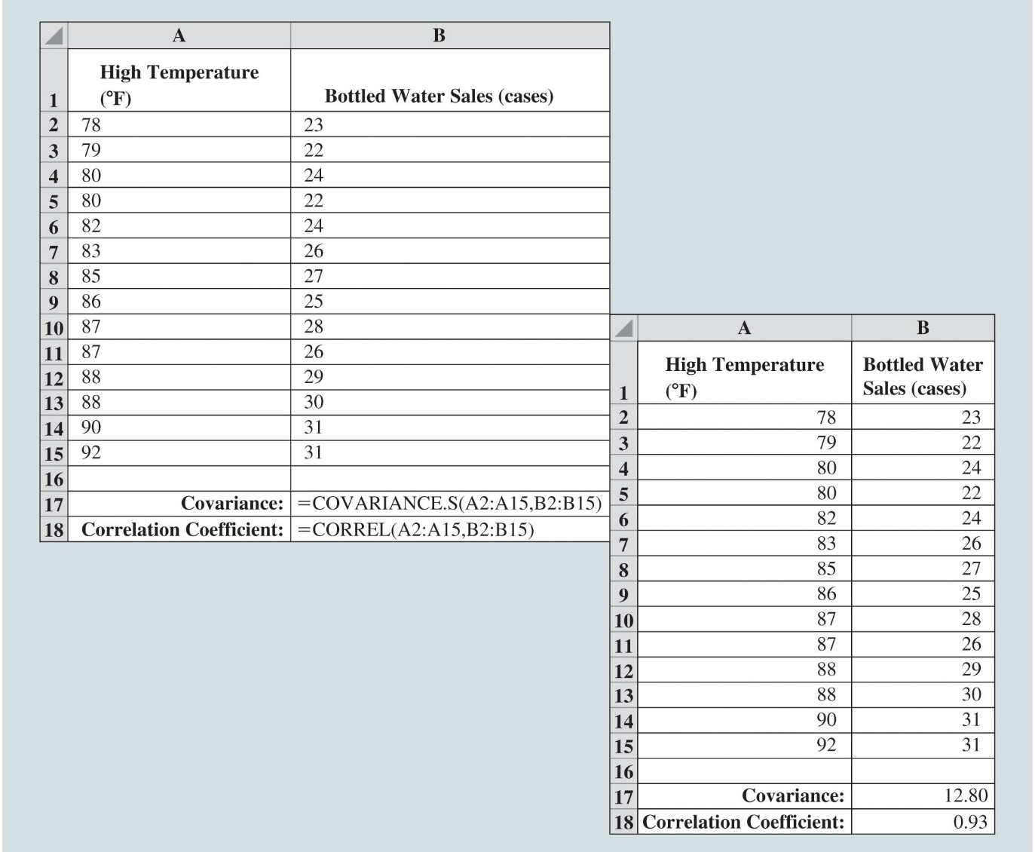
Measures of Association between Two Variables (Slide 6 of 11)
Figure 2.27: Calculating Covariance and Correlation Coefficient for Bottled Water Sales Using Excel
Notes:
Computation of covariance and correlation coefficient in Excel:
Figure 2.27 shows the data from Table 2.14 entered into an Excel Worksheet.
The covariance is calculated in cell B17 using the formula =COVARIANCE.S(A2:A15, B2:B15). The A2:A15 defines the range for the x variable (high temperature), and B2:B15 defines the range for the y variable (sales of bottled water).
The correlation coefficient in Figure 2.27 is computed in cell B18 for the sales of bottled water using the formula =CORREL(A2:A15, B2:B15) where A2:A15 defines the range for the x variable and B2:B15 defines the range for the y variable.

Slide 96
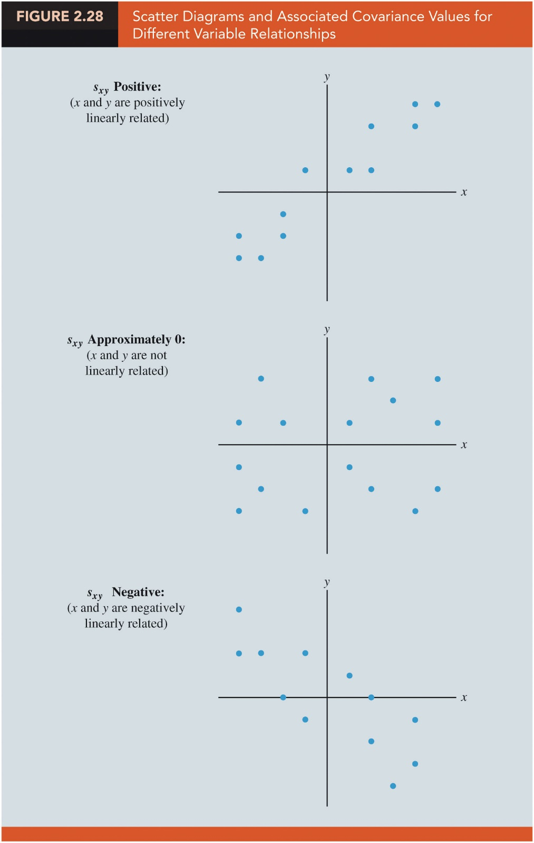

Measures of Association between Two Variables (Slide 7 of 11)
Figure 2.28: Scatter Diagrams and Associated Covariance Values for Different Variable Relationships
(a)
(b)
(c)
Positive:
(x and y are positively
linearly related)
Approximately 0:
(x and y are not
linearly related)
Negative:
(x and y are negatively
linearly related)

Slide 97
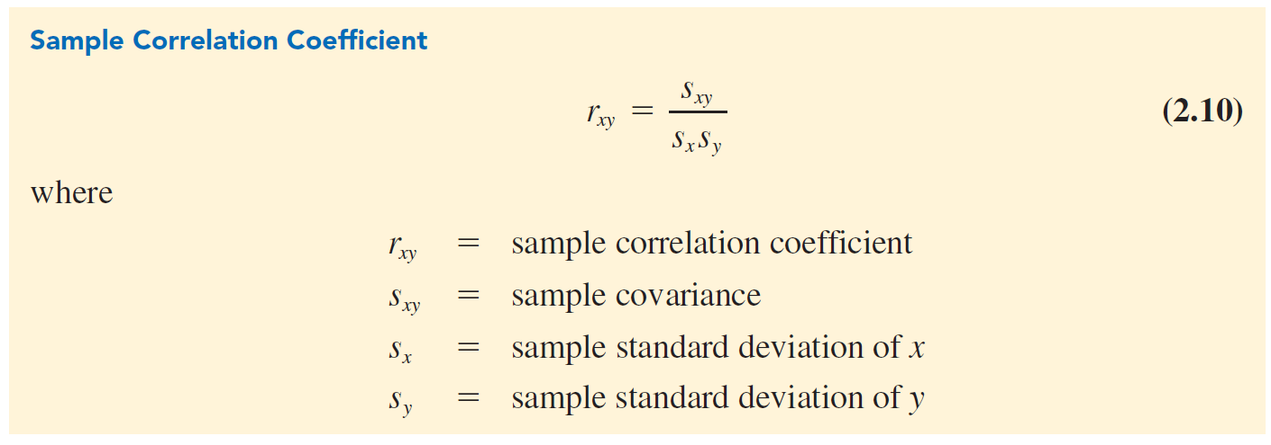
Measures of Association between Two Variables (Slide 8 of 11)
Correlation Coefficient:
The correlation coefficient measures the relationship between two variables.
Not affected by the units of measurement for x and y.
Notes:
Population correlation coefficient is denoted by $ρ_{xy}$.
$ρ_{xy}$ = $\frac{σ_{xy}}{σ_{x}σ_{y}}$
$σ_{xy}$ = population covariance = $\frac{\sum{\left(x_{i} − {\text{µ }}_{x}\right)\left(y_{i} − {\text{µ }}_{y}\right)}}{N}$.
$σ_{x}$ = population standard deviation of x = $\sqrt{\frac{{\sum{\left(x_{i} −{\text{µ }}_{x}\right)}}^{2}}{N}}$.
$σ_{y}$ = population standard deviation of y = $\sqrt{\frac{{\sum{\left(y_{i} −{\text{µ }}_{y}\right)}}^{2}}{N}}$.

Slide 98
Measures of Association between Two Variables (Slide 9 of 11)
Interpretation of Correlation Coefficient
r value | Relationship between the x and y variables
< 0 | Negative linear
Near 0 | No linear relationship
> 0 | Positive linear
Notes:
The closer the correlation coefficient is to +1, the closer the x and y values are to forming a straight line that trends upward to the right (positive slope).
The closer the correlation coefficient is to –1, the closer the x and y values are to forming a straight line with negative slope.

Slide 99
Measures of Association between Two Variables (Slide 10 of 11)
Computation of Correlation Coefficient
Illustration:
To determine the sample correlation coefficient for bottled water sales at Queensland Amusement Park:
There is a very strong linear relationship between high temperature and sales.
Notes:
We have already obtained the value of $s_{xy}$ as 12.8.
Using data in Table 2.14, we can compute sample standard deviations for x and y.
${ s}_{x}\text{=}\sqrt{\frac{{\sum{\left(x_{i}−\overline{x}\right)}}^{2}}{n−1}}$ = 4.36
$s_{y}\text{=}\sqrt{\frac{{\sum{\left(y_{i}−\overline{y}\right)}}^{2}}{n−1}}$ = 3.15

Slide 100
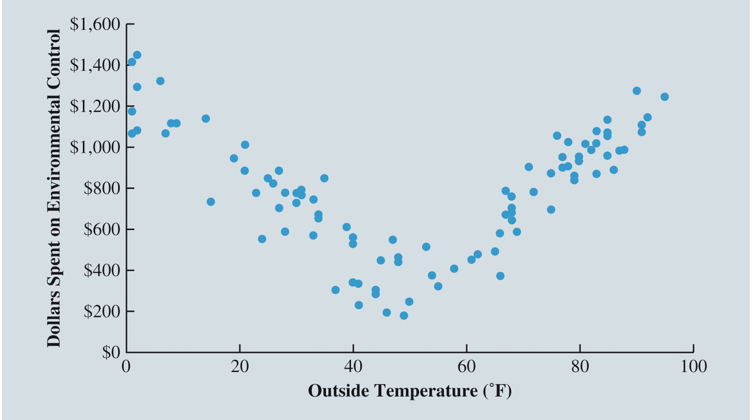
Measures of Association between Two Variables (Slide 11 of 11)
Figure 2.29: Example of Nonlinear Relationship Producing a Correlation Coefficient Near Zero
Notes:
The scatter diagram in Figure 2.29 shows the relationship between the amount spent by a small retail store for environmental control (heating and cooling) and the daily high outside temperature over 100 days.
The sample correlation coefficient for these data is r_{xy} = –0.007 and indicates that there is no linear relationship between the two variables.
However, Figure 2.29 provides strong visual evidence of a nonlinear relationship.
That is, we can see that as the daily high outside temperature increases, the money spent on environmental control first decreases as less heating is required and then increases as greater cooling is required.

Slide 101
Data Cleansing
Missing Data
Blakely Tires
Identification of Erroneous Outliers and Other Erroneous Values
Variable Representation

Slide 102
Data Cleansing (Slide 1 of 11)
Missing Data
Data sets commonly include observations with missing values for one or more variables.
In some cases missing data naturally occur; these are called legitimately missing data.
Generally, no remedial action is taken for legitimately missing data.
In other cases missing data occur for different reasons; these are called illegitimately missing data.
The primary options for addressing such missing data are
To discard observations (rows) with any missing values.
To discard any variable (column) with missing values.
To fill in missing entries with estimated values.
To apply a data-mining algorithm that can handle missing values.

Slide 103
Data Cleansing (Slide 2 of 11)
Missing Data (cont.)
Missing completely at random (MCAR): The tendency for an observation to be missing the value for some variable is entirely random; whether data are missing does not depend on either the value of the missing data or the value of any other variable in the data.
Missing at random (MAR): The tendency for an observation to be missing a value for some variable is related to the value of some other variable(s) in the data.
Missing not at random (MNAR): The tendency for the value of a variable to be missing is related to the value that is missing.
Imputation: The systematic replacement of missing values with values that seem reasonable.

Slide 104
Data Cleansing (Slide 3 of 11)
Blakely Tires
A U.S. producer of automobile tires wants to learn about the conditions of its tires on automobiles in Texas.
The data obtained includes the position of the tire on the automobile, age of the tire, mileage on the tire, and depth of the remaining tread on the tire.
Begin assessing the quality of these data by determining which (if any) observations have missing values (see Figure 2.30).

Slide 105
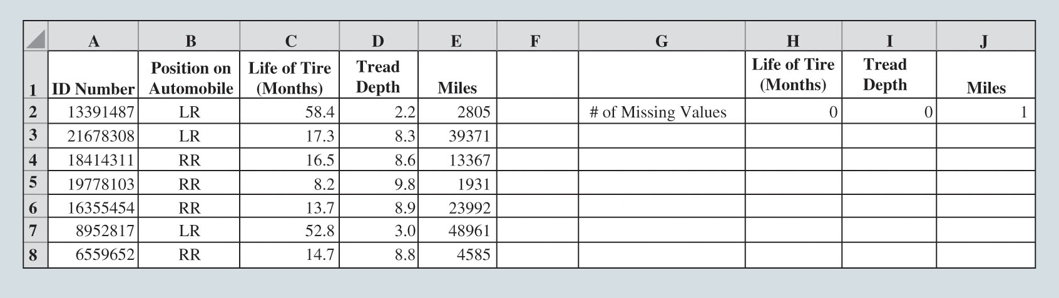
Data Cleansing (Slide 4 of 11)
Figure 2.30: Portion of Excel Spreadsheet Showing Number of Missing Values for Variables in TreadWear Data

Slide 106
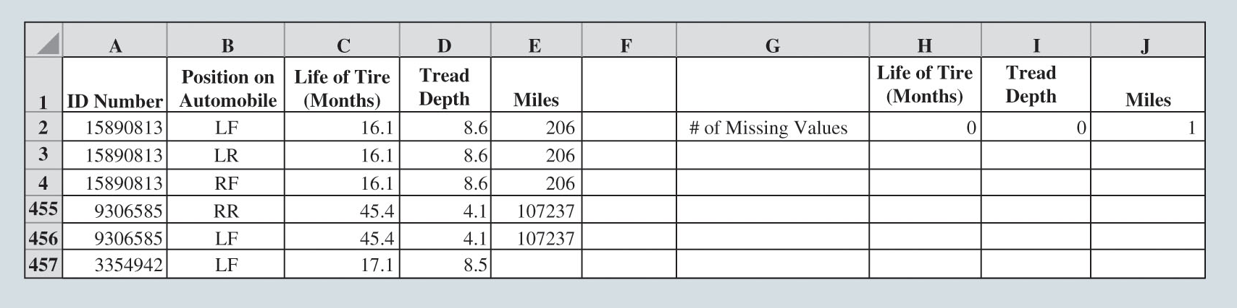
Data Cleansing (Slide 5 of 11)
Blakely Tires (cont.)
Sort all of Blakely’s data on Miles from smallest to largest value to determine which observation is missing its value of this variable.
Figure 2.31: Portion of Excel Spreadsheet Showing TreadWear Data Sorted on Miles from Lowest to Highest Value

Slide 107
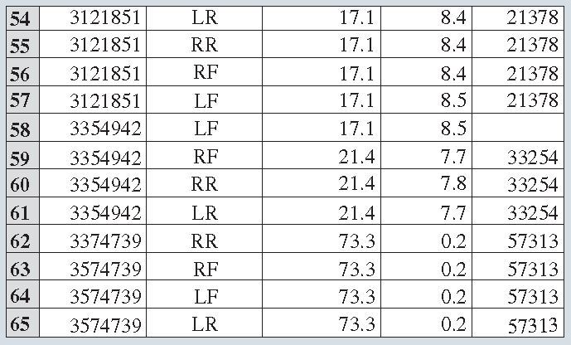
Data Cleansing (Slide 6 of 11)
Figure 2.32: Portion of Excel Spreadsheet Showing TreadWear Data Sorted from Lowest to Highest by ID Number

Slide 108
Data Cleansing (Slide 7 of 11)
Identification of Erroneous Outliers and Other Erroneous Values
Examining the variables in the data set by use of summary statistics, frequency distributions, bar charts and histograms, z-scores, scatter plots, correlation coefficients, and other tools can uncover data-quality issues and outliers.
Many software ignore missing values when calculating various summary statistics.
If missing values in a data set are indicated with a unique value (such as 9999999), these values may be used by software when calculating various summary statistics.
Both cases can result in misleading values for summary statistics.
Many analysts prefer to deal with missing data issues prior to using summary statistics to attempt to identify erroneous outliers and other erroneous values in the data.

Slide 109
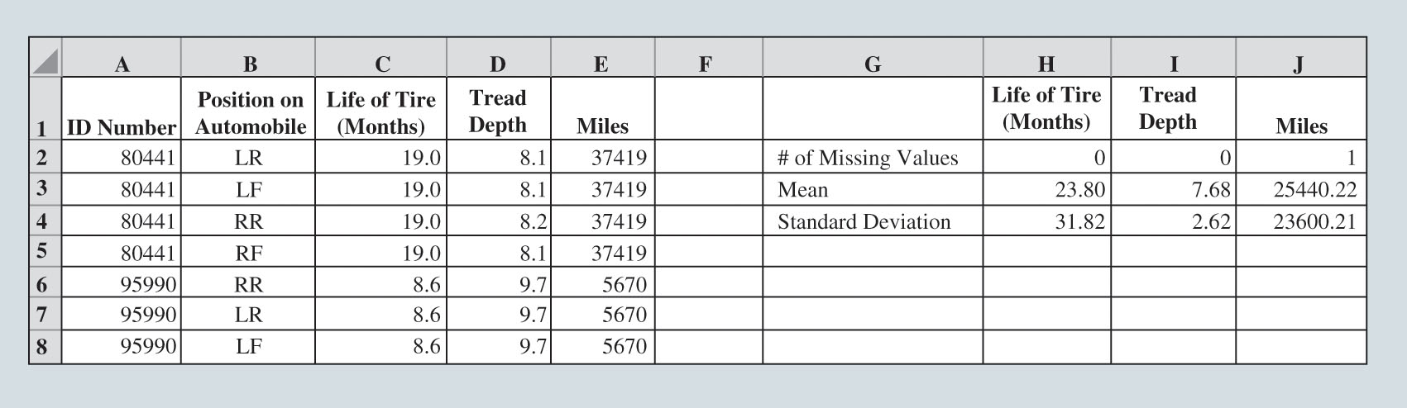
Data Cleansing (Slide 8 of 11)
Figure 2.33: Portion of Excel Spreadsheet Showing the Mean and Standard Deviation for Each Variable in the TreadWear Data

Slide 110
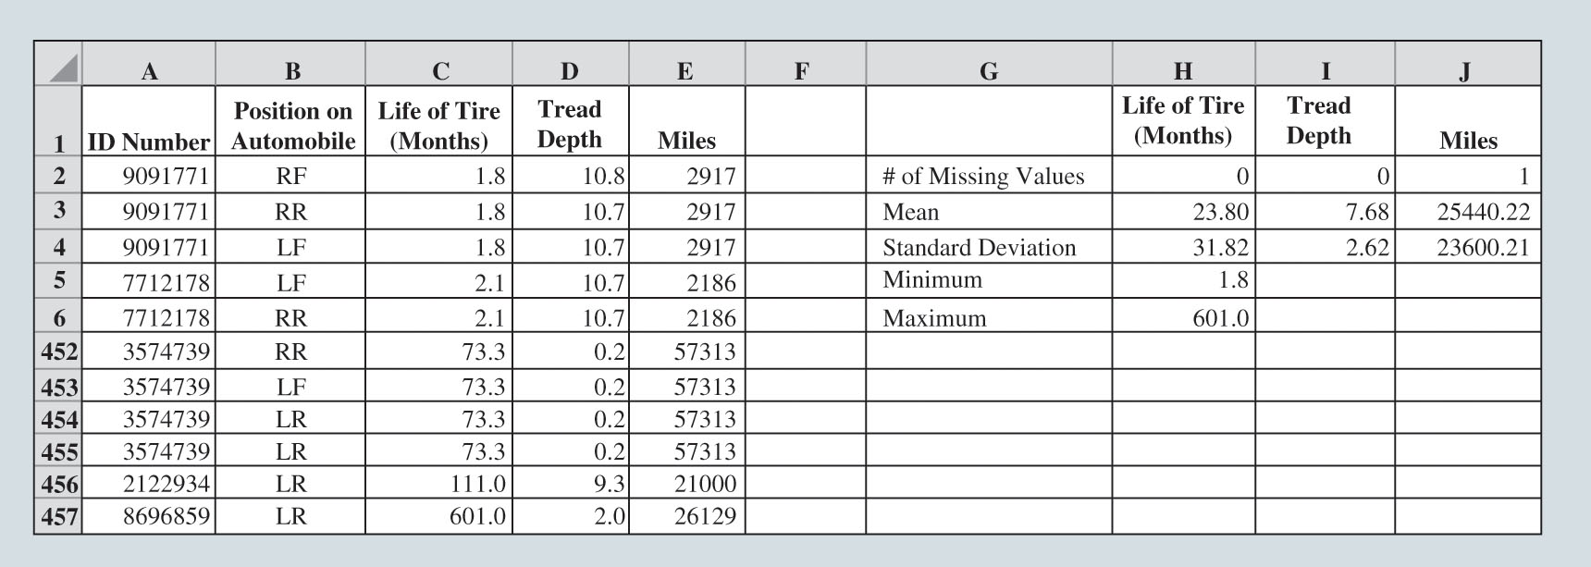
Data Cleansing (Slide 9 of 11)
Figure 2.34: Portion of Excel Spreadsheet Showing the TreadWear Data Sorted on Life of Tires (Months) from Lowest to Highest Value

Slide 111
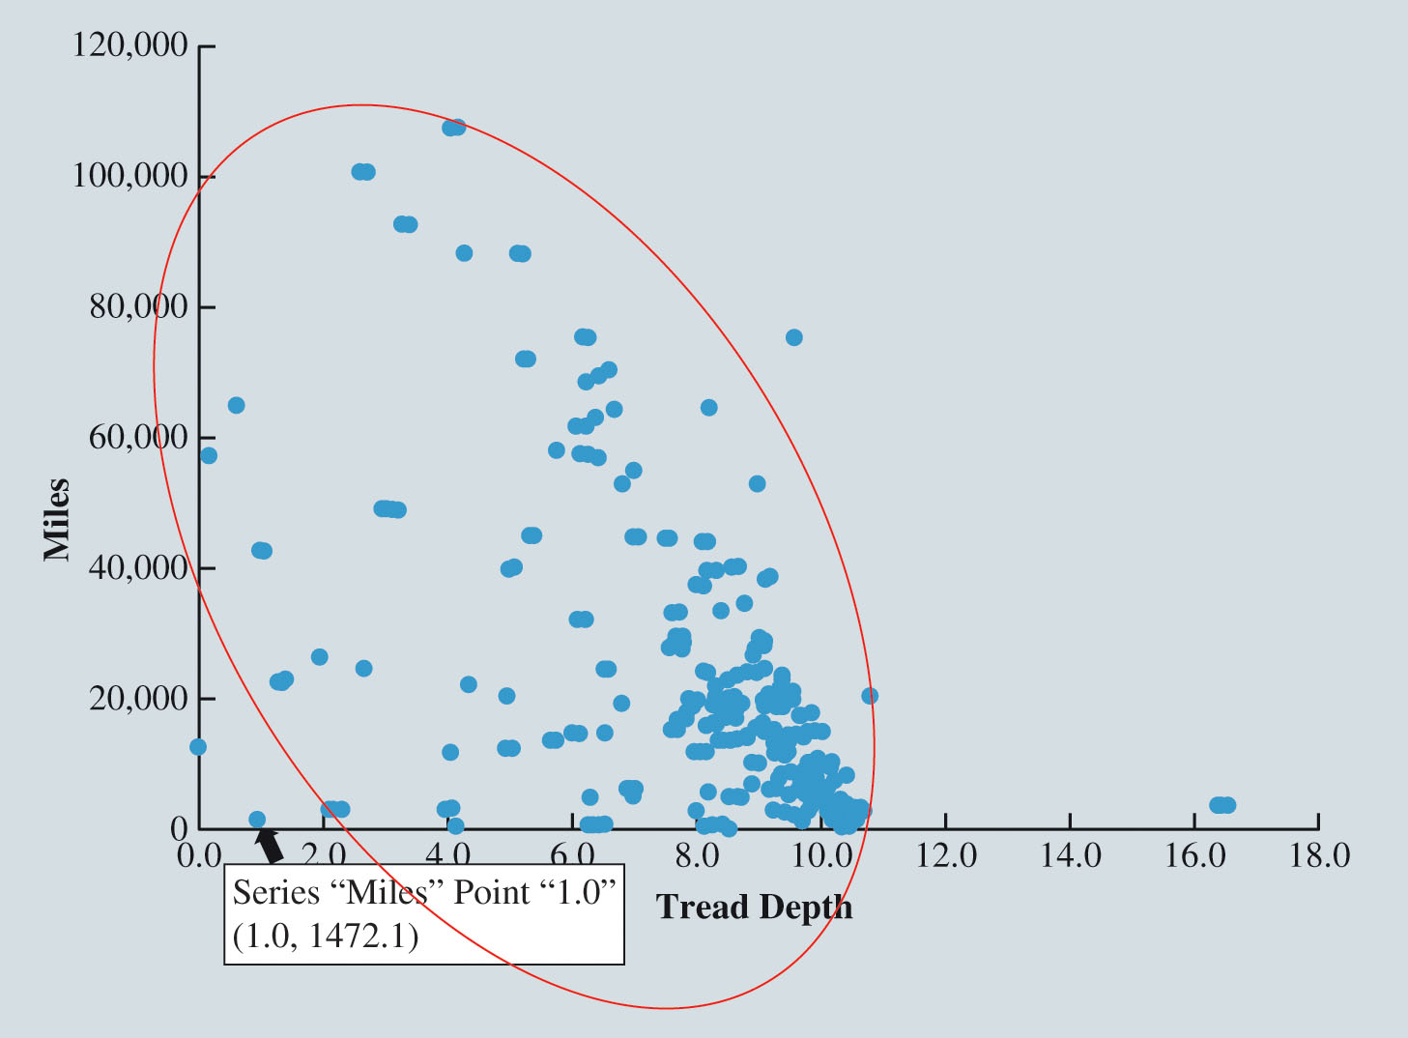
Data Cleansing (Slide 10 of 11)
Figure 2.35: Scatter Diagram of Tread Depth and Miles for the TreadWear Data

Slide 112
Data Cleansing (Slide 11 of 11)
Variable Representation
In many data-mining applications, it may be prohibitive to analyze the data because of the number of variables recorded.
Dimension reduction is the process of removing variables from the analysis without losing crucial information.
A critical part of data mining is determining how to represent the measurements of the variables and which variables to consider.
Often data sets contain variables that, considered separately, are not particularly insightful but that, when appropriately combined, result in a new variable that reveals an important relationship.

